Slide 1
Course Name:
Web Application Development- Dot Net
Project Title:
SMALL BUSINESS MANAGEMENT SYSTEM
Batch: 06
Group Name: DotNetForever
Team Members
Sl | SEID | Name
1 | 26 26 09 | Khandokar Mahidy Hasan
2 | 25 56 49 | MD. Abdullah Sayket
3 | 26 30 42 | Tania Akther
4 | 26 33 70 | Sadia Sharmin

Slide 2
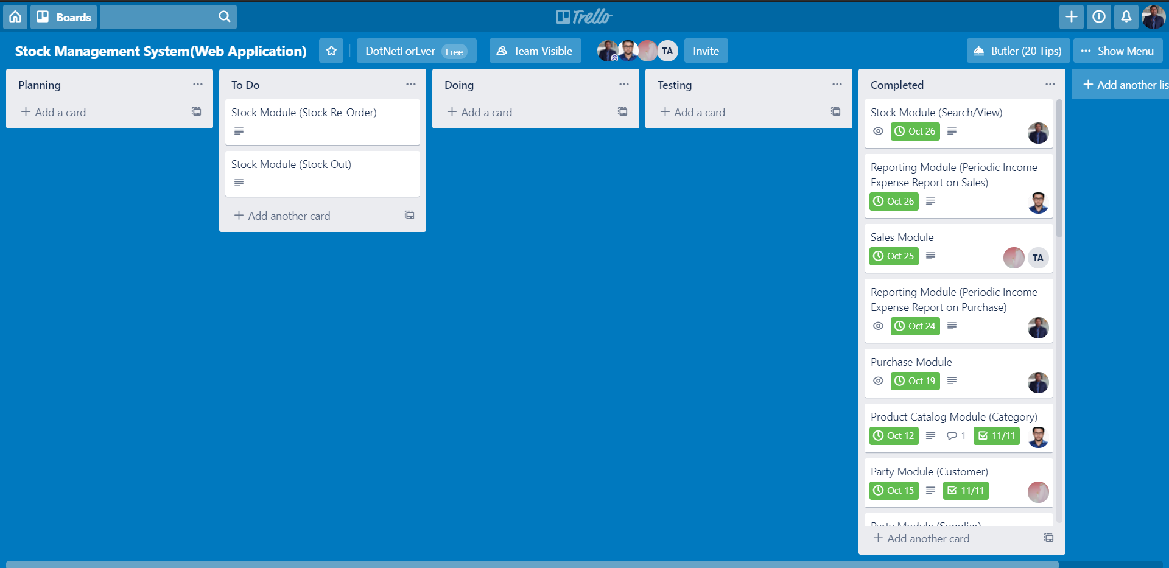
Project Management Using Trello

Slide 3
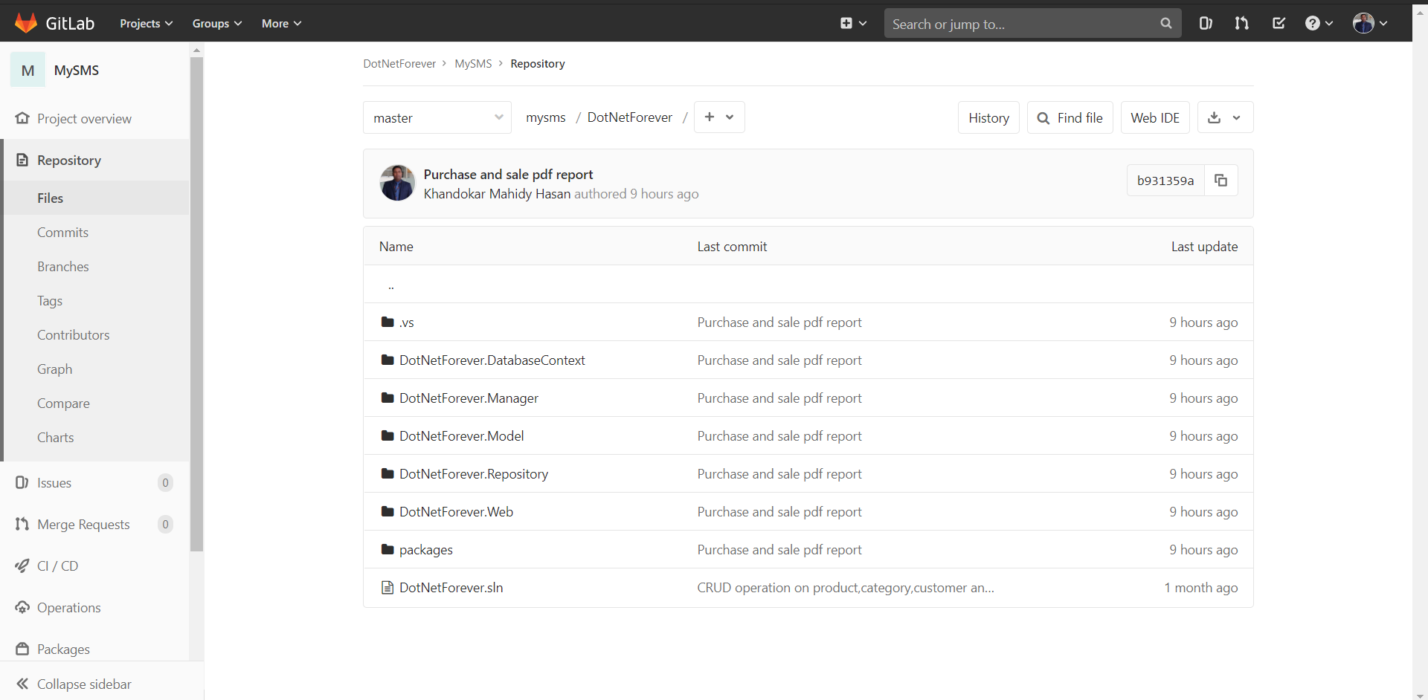
Software Version Control Using Git & GitLab

Slide 4
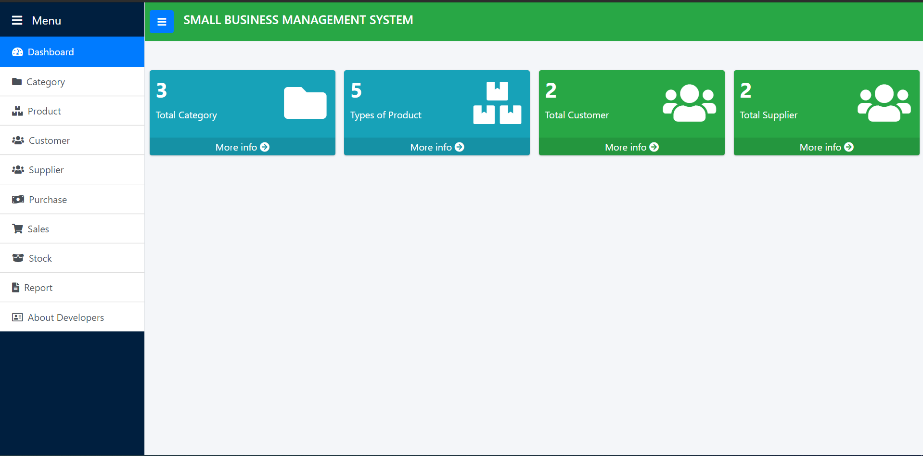
Dashboard

Slide 5
DProduct Catalog Module (Category)ashbor

Slide 6
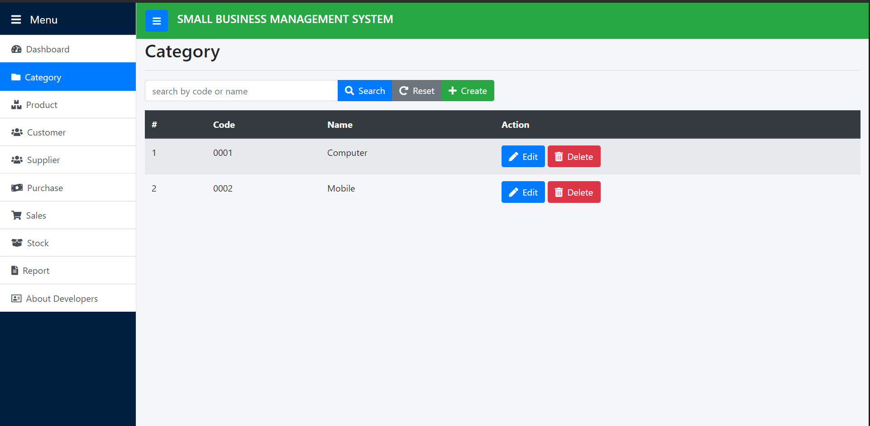
Category List

Slide 7
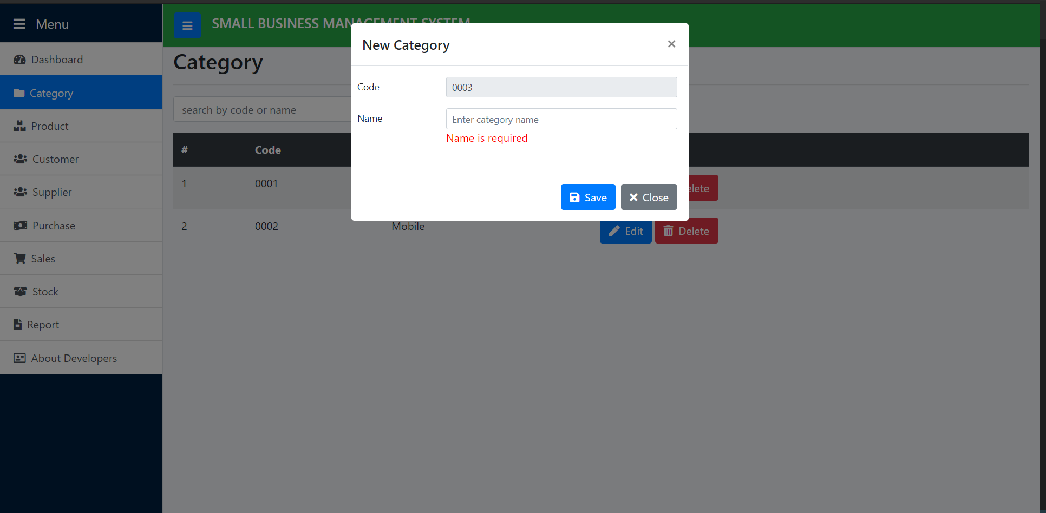
Add New Category

Slide 8
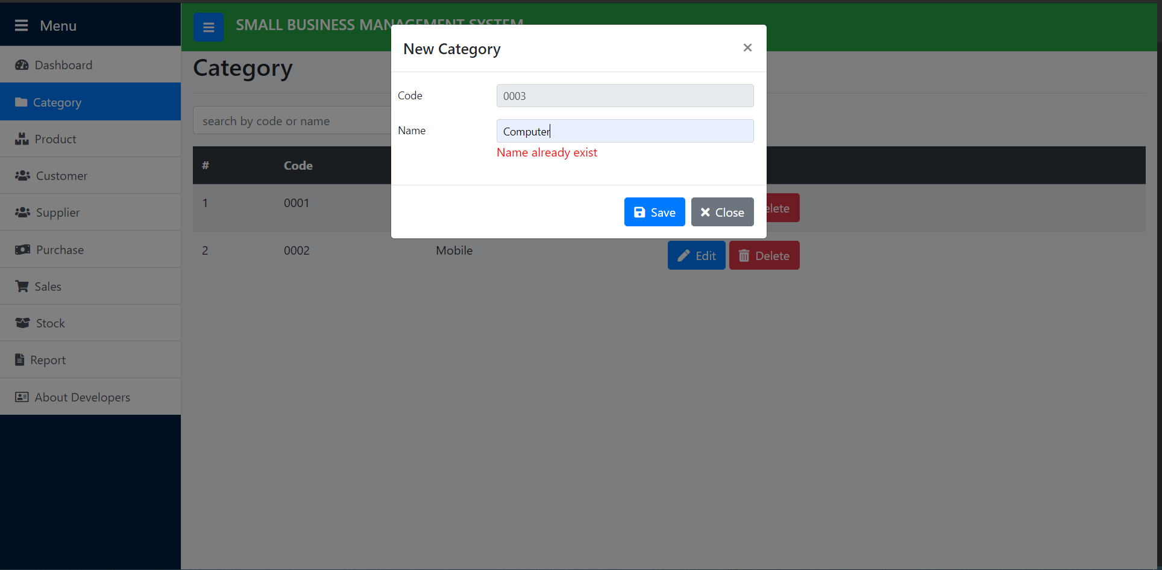
Category Name Unique

Slide 9
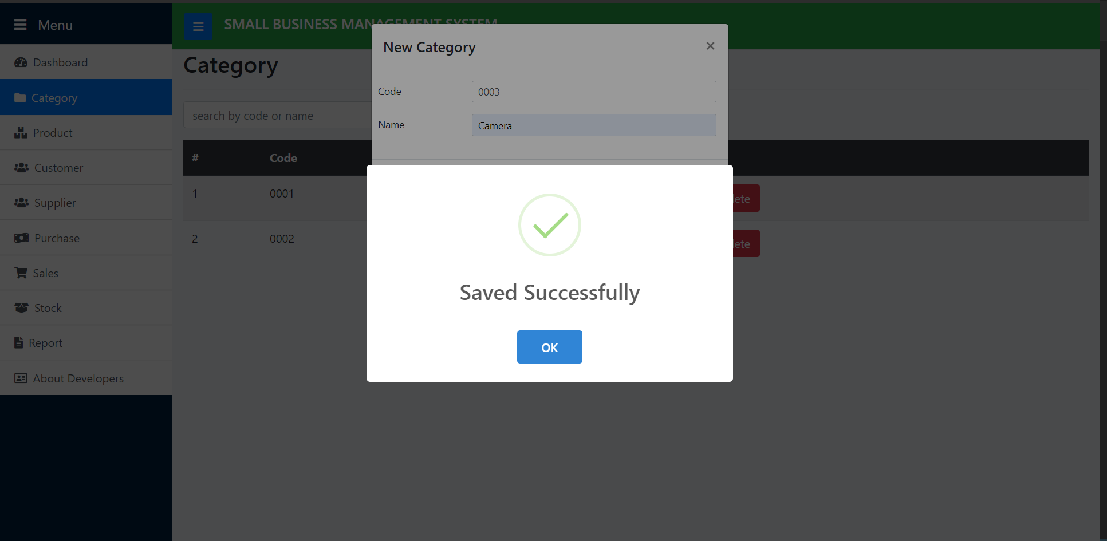
Save Category

Slide 10
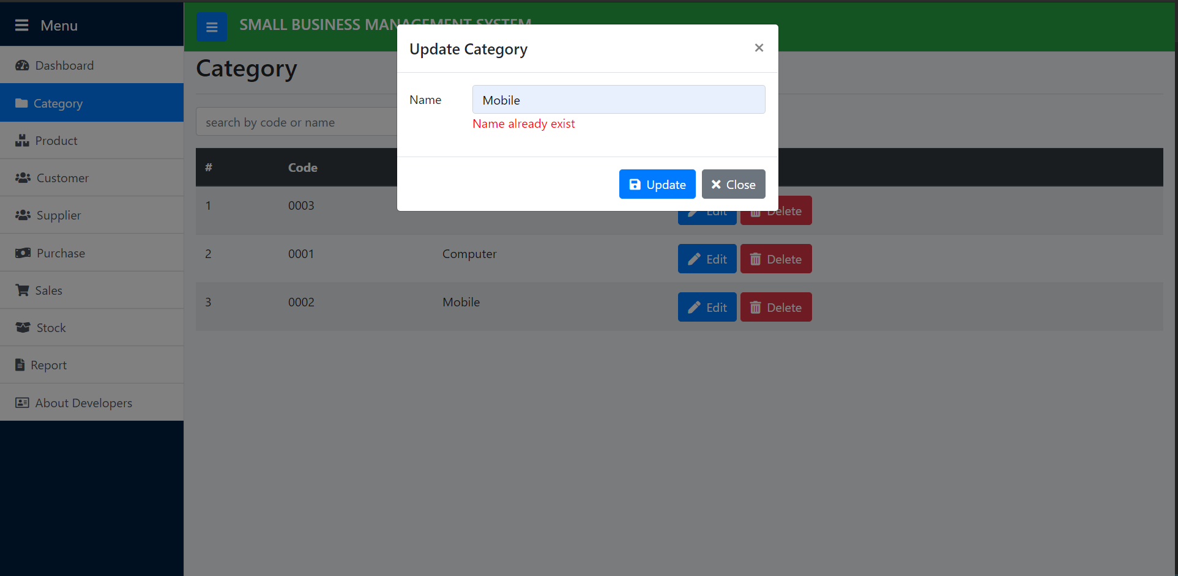
Update Category

Slide 11
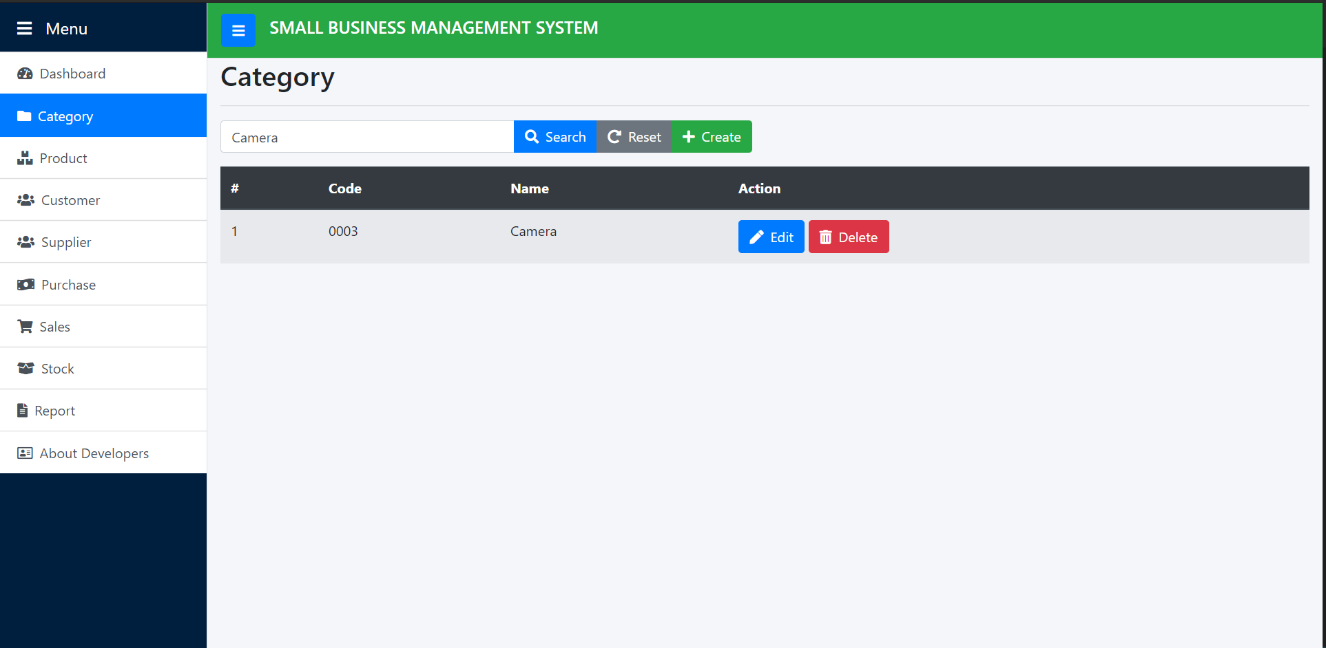
Search Category

Slide 12
Product Catalog Module (Product)

Slide 13
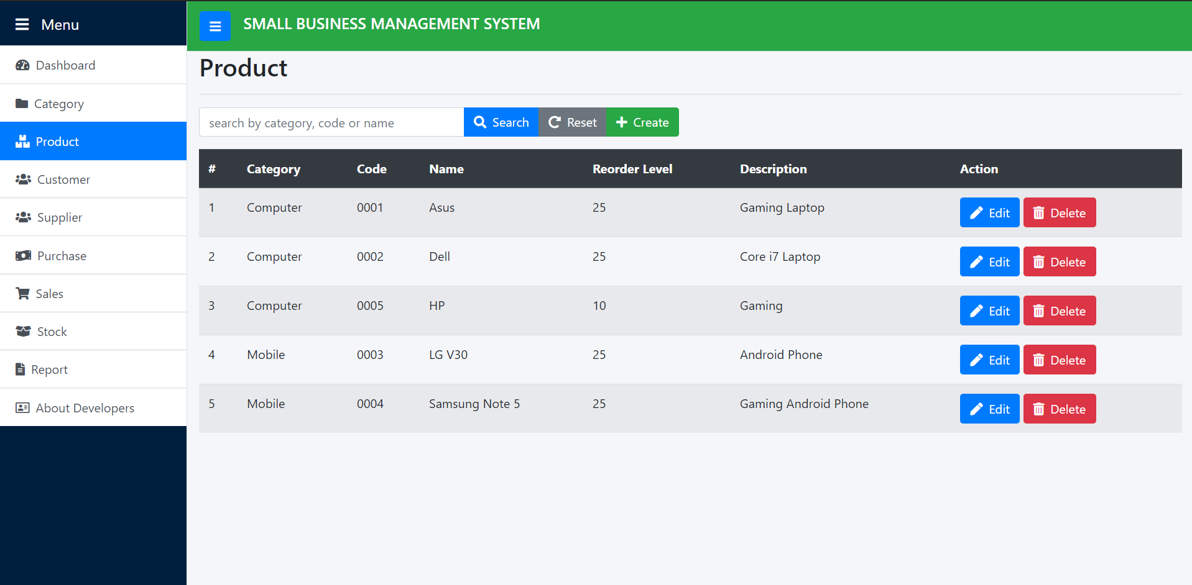
Product List

Slide 14
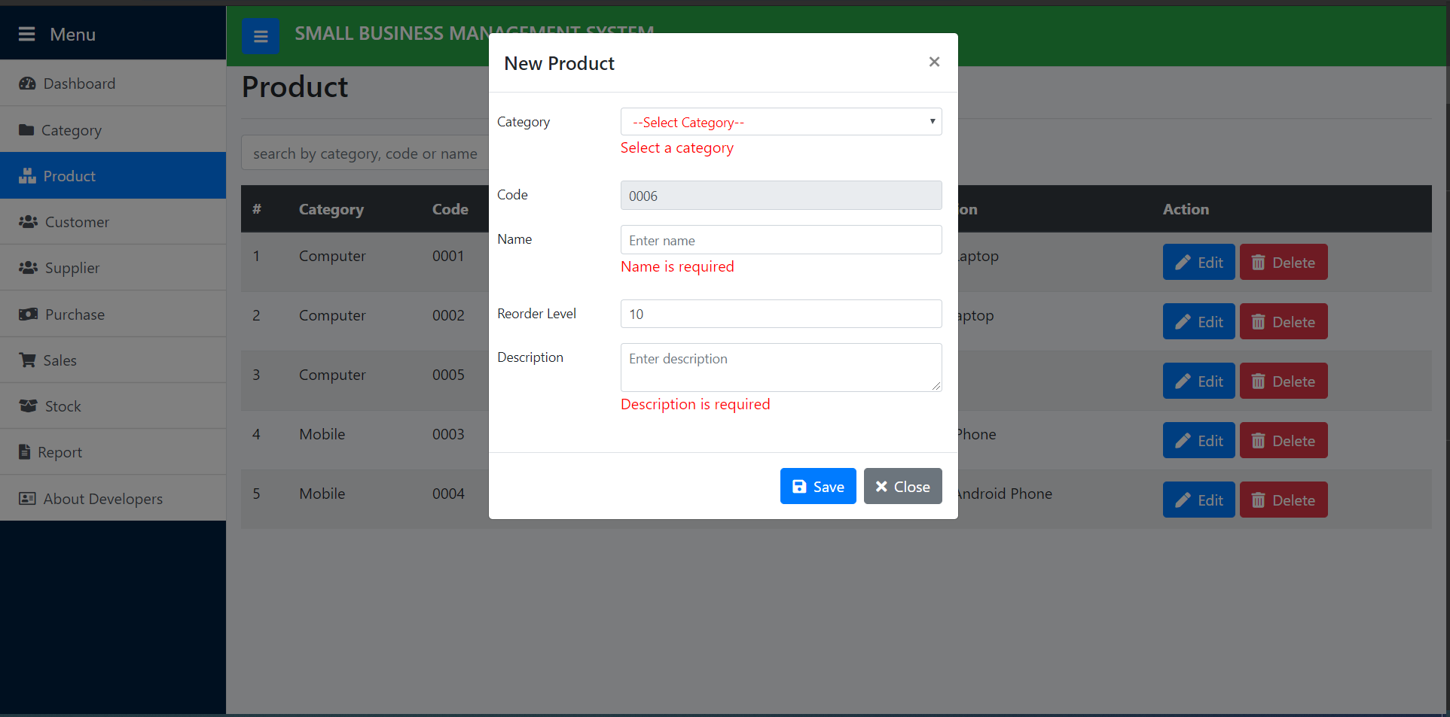
Add New Product

Slide 15
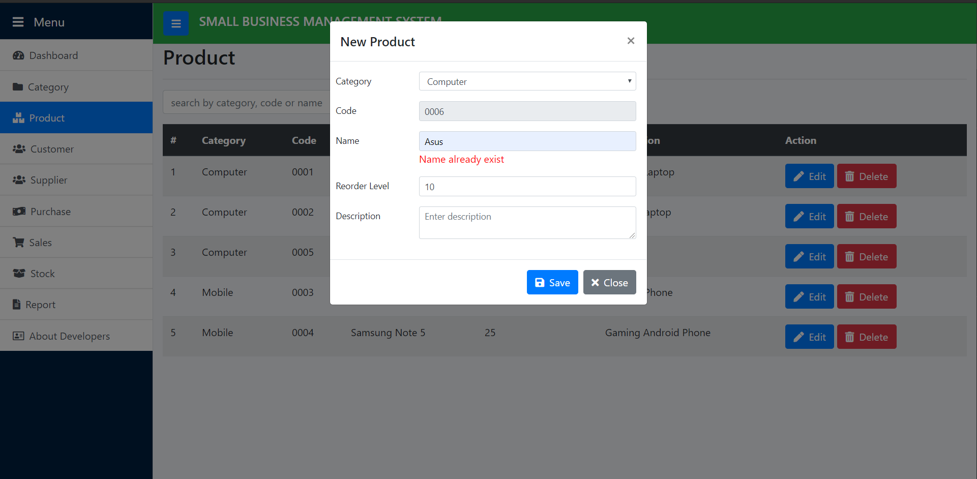
Product Unique Name

Slide 16
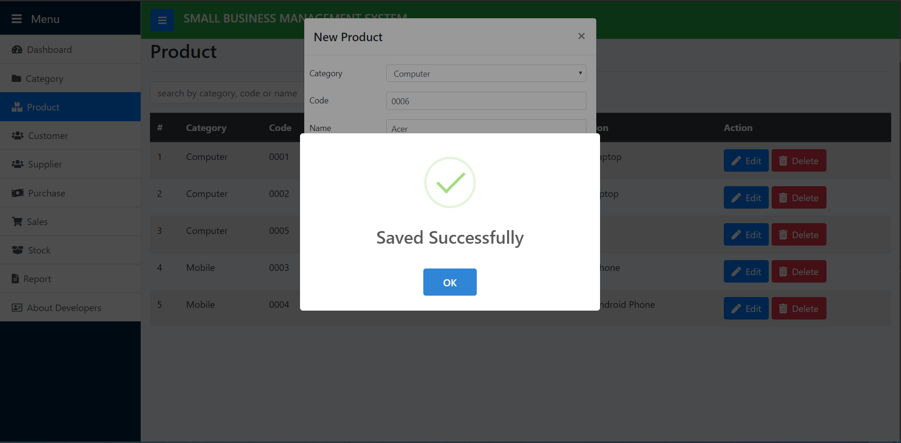
Save Product

Slide 17
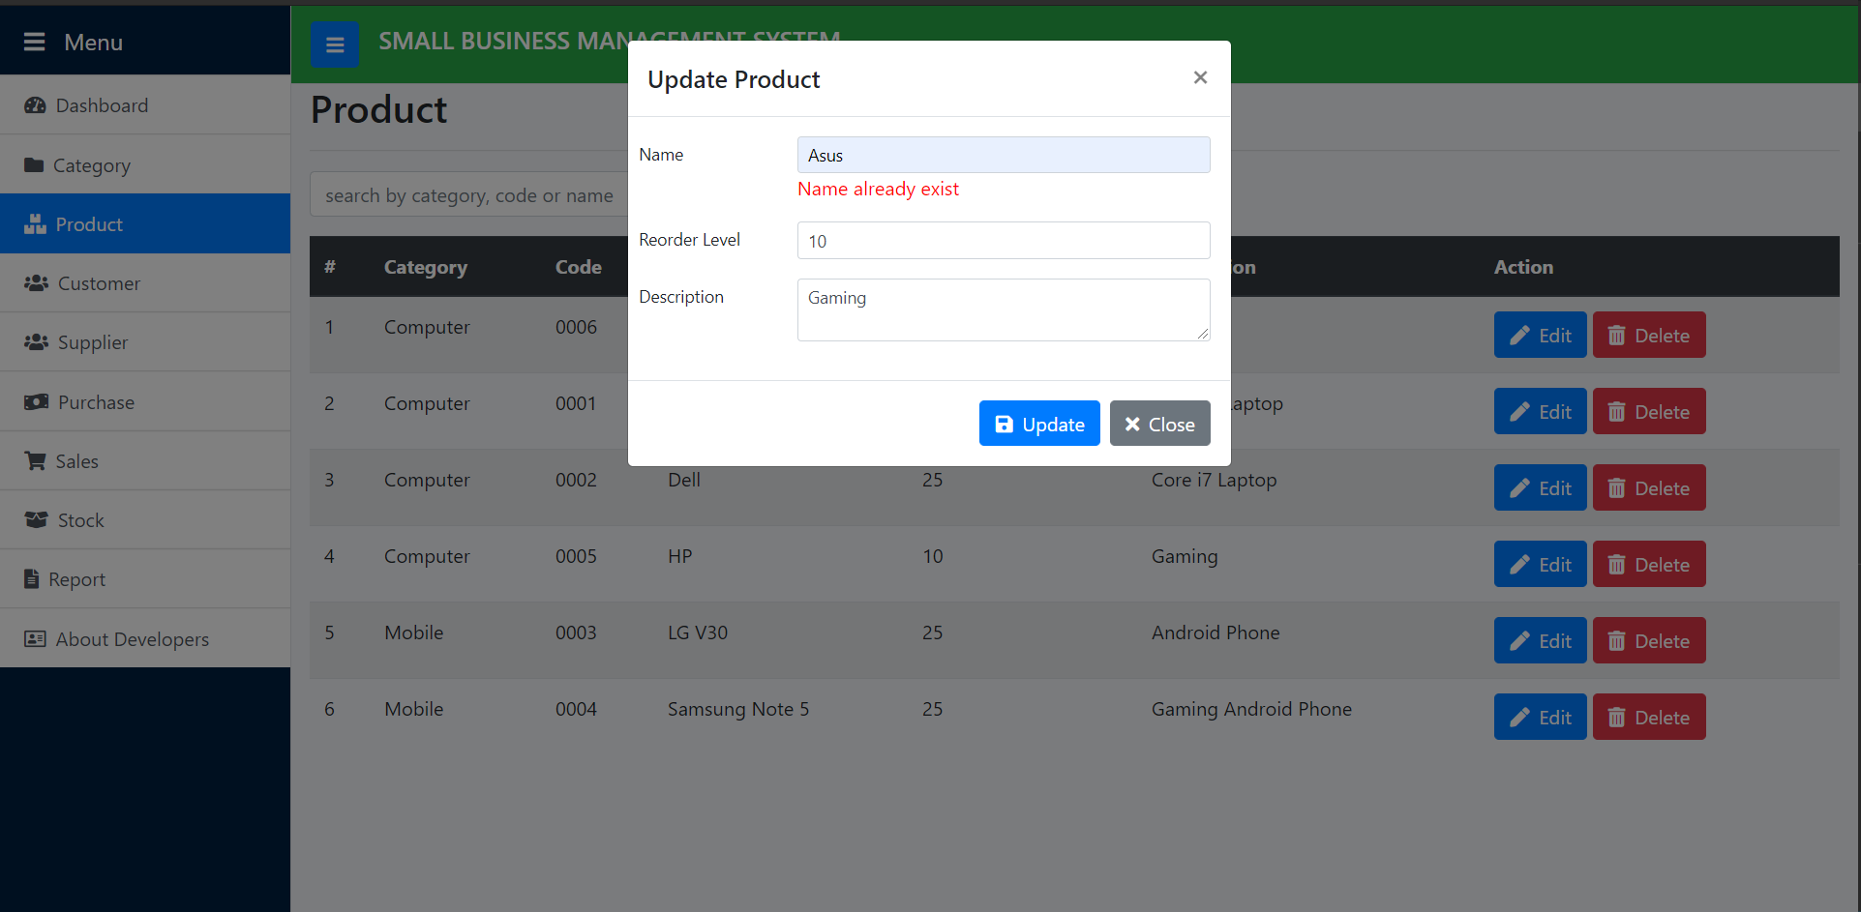
Update Product Unique Name

Slide 18
Party Module (Customer)

Slide 19
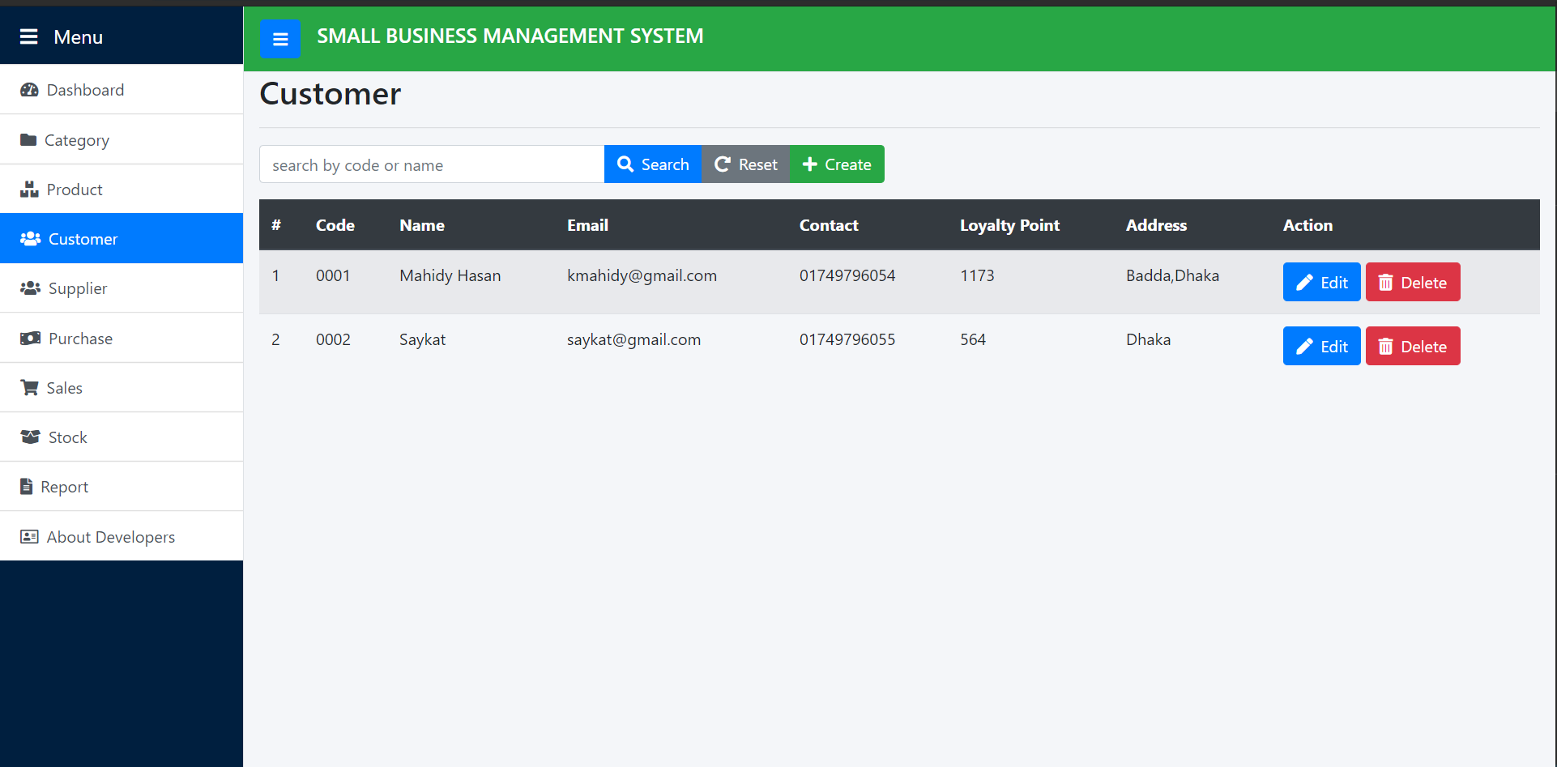
Customer List

Slide 20
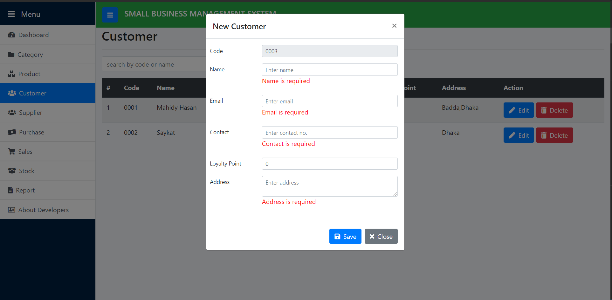
Add New Customer

Slide 21
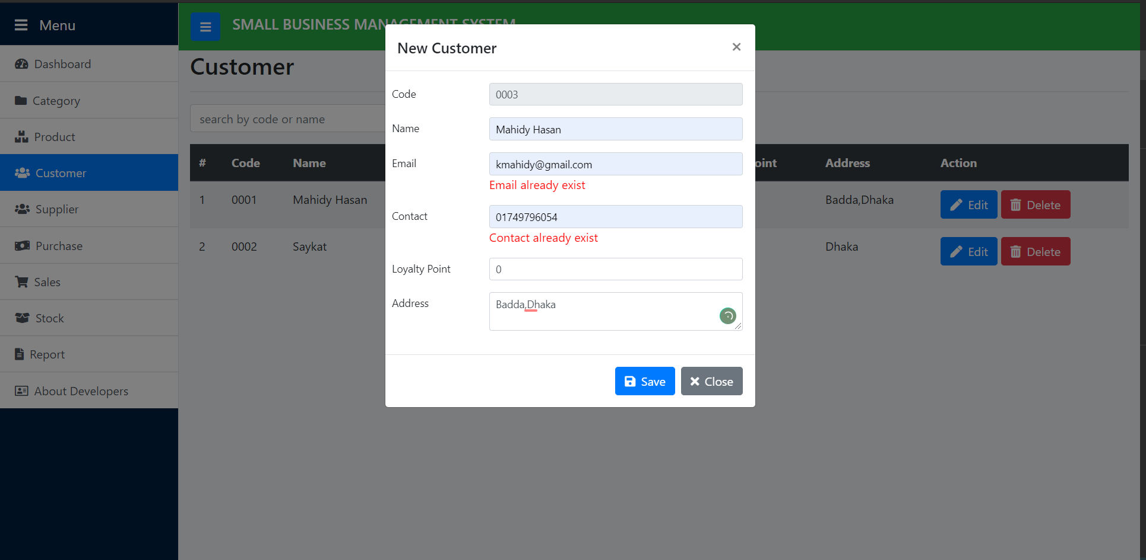
Customer Unique Email and Unique Contact

Slide 22
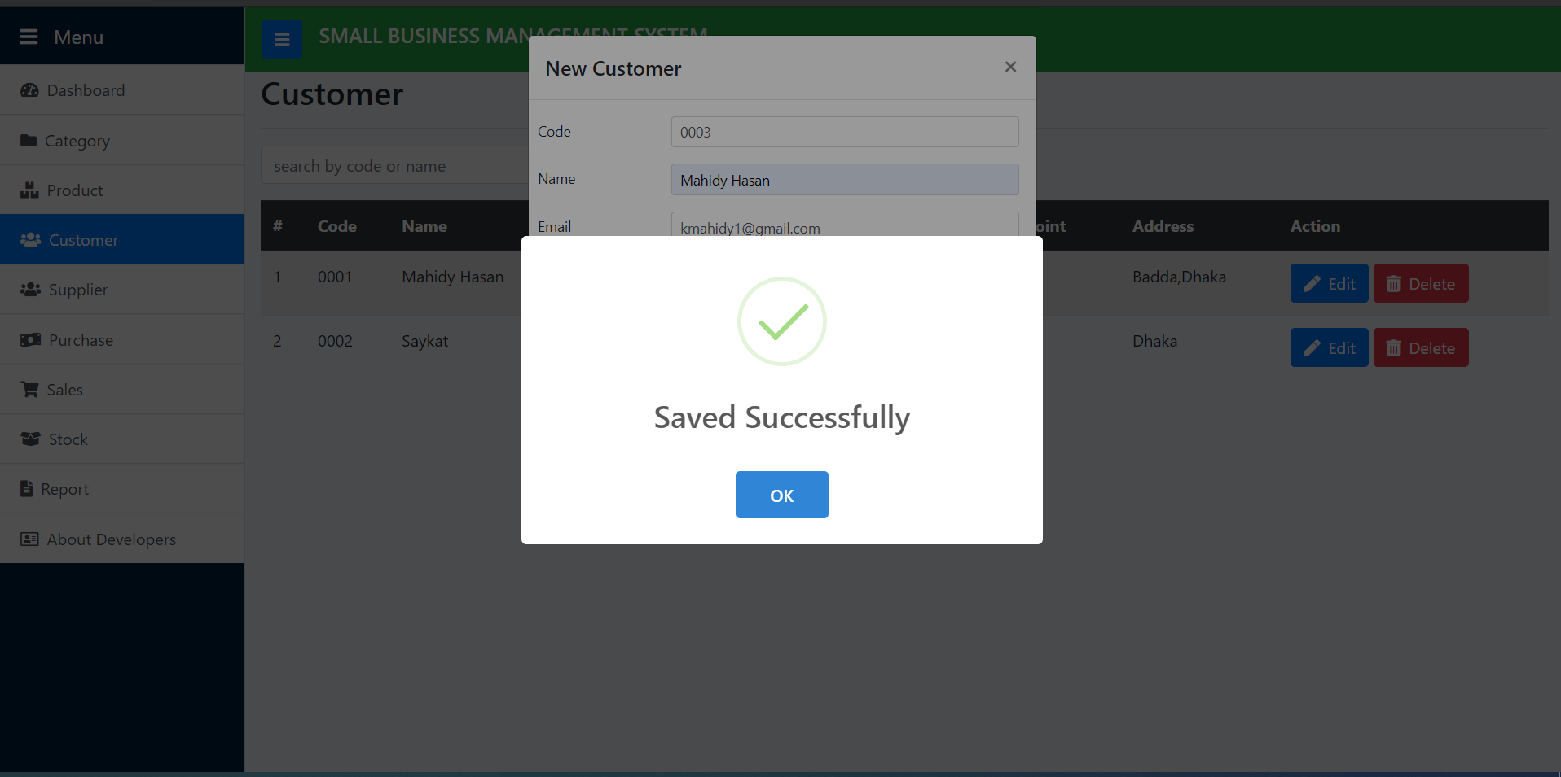
Customer Save

Slide 23
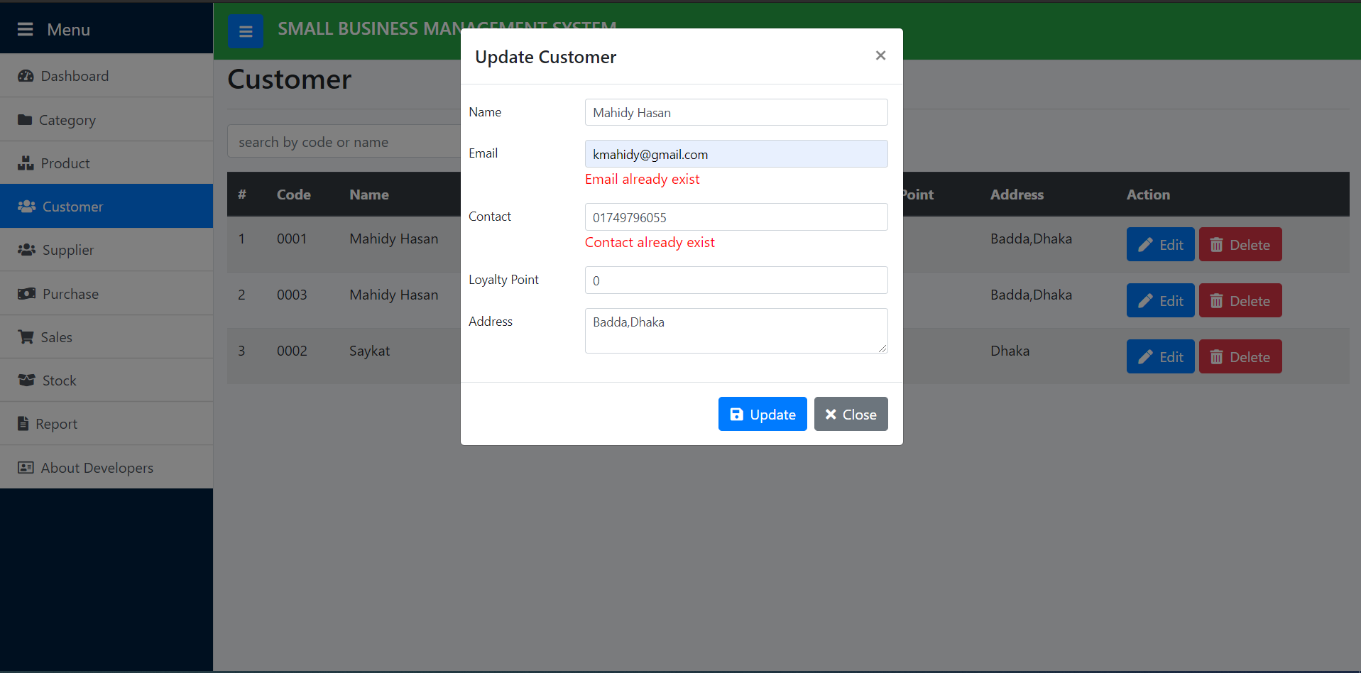
Update Customer Unique Email and Unique Contact

Slide 24
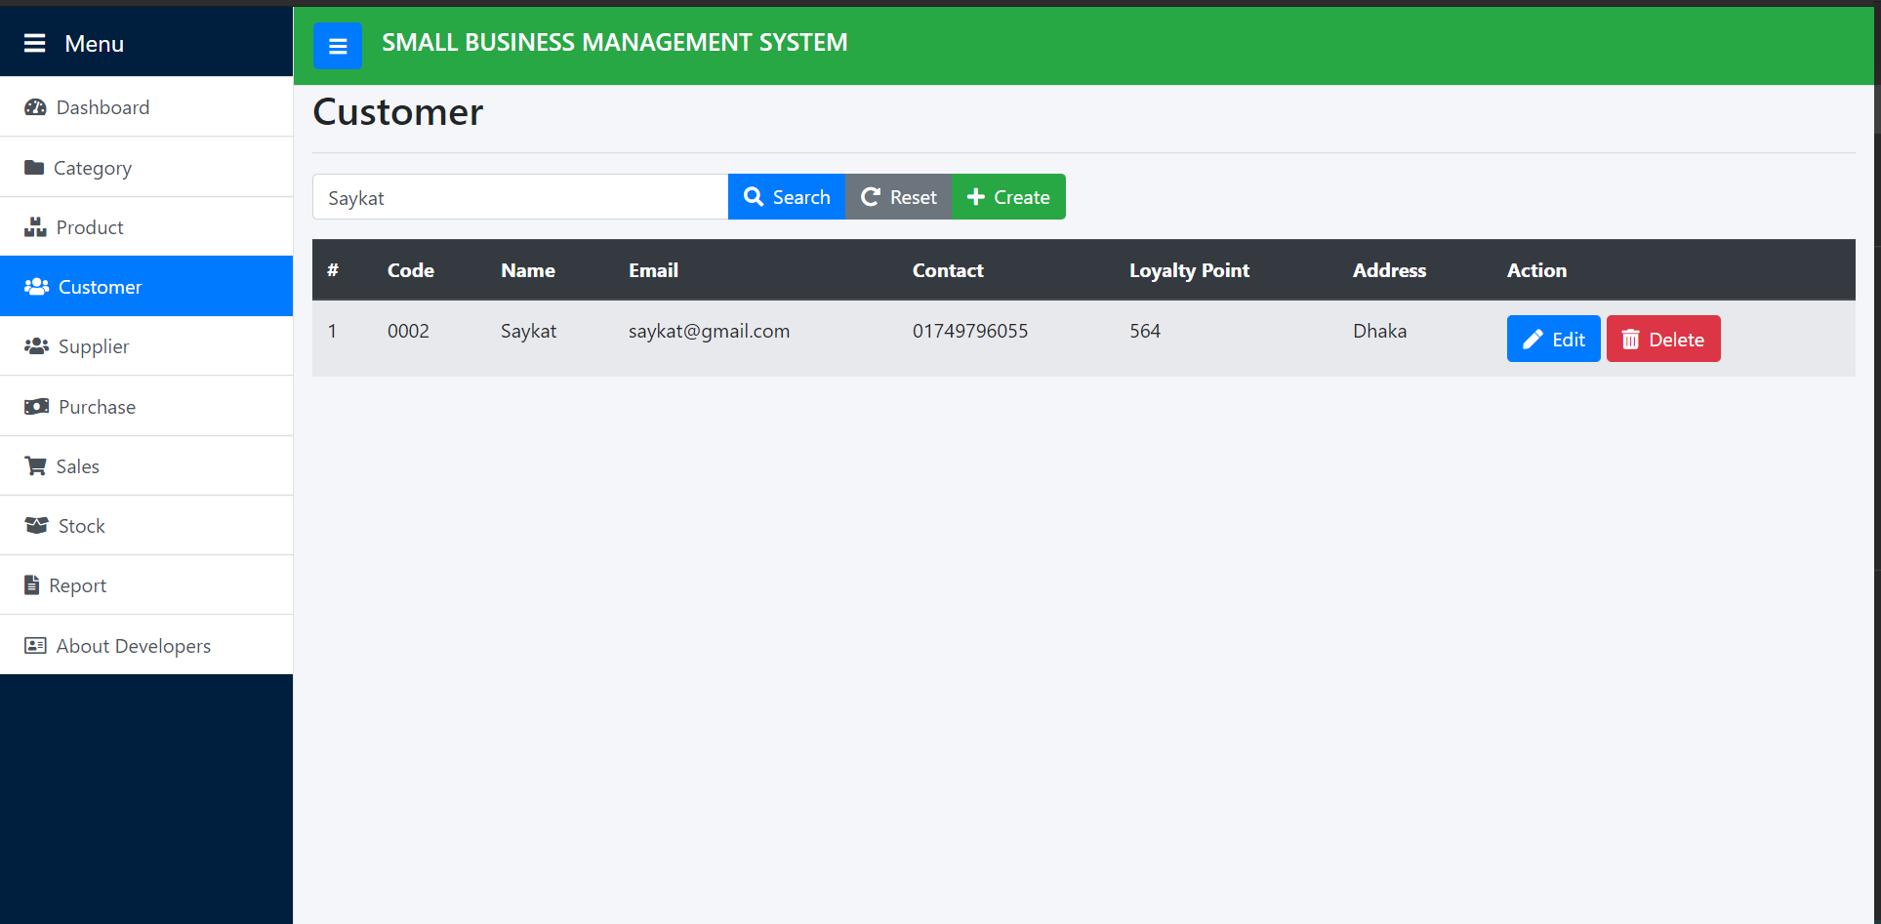
Search Customer

Slide 25
Party Module (Supplier)

Slide 26
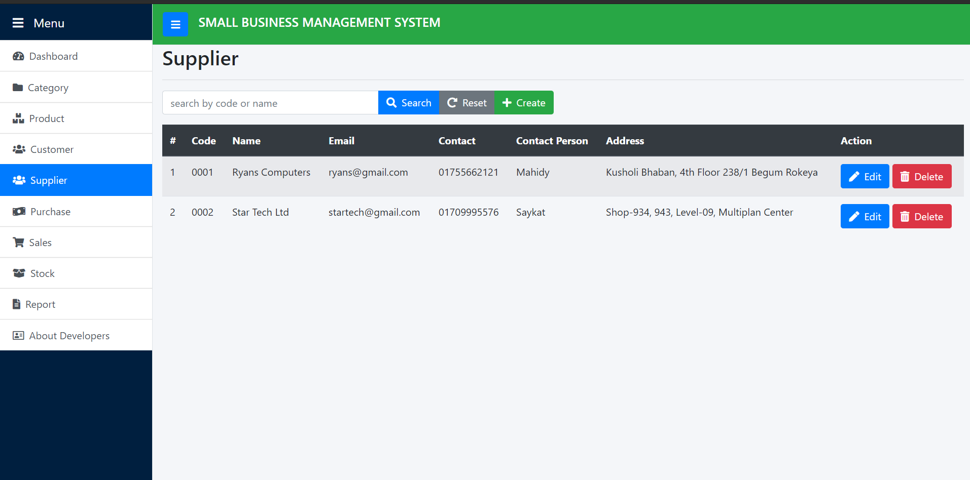
Supplier List

Slide 27
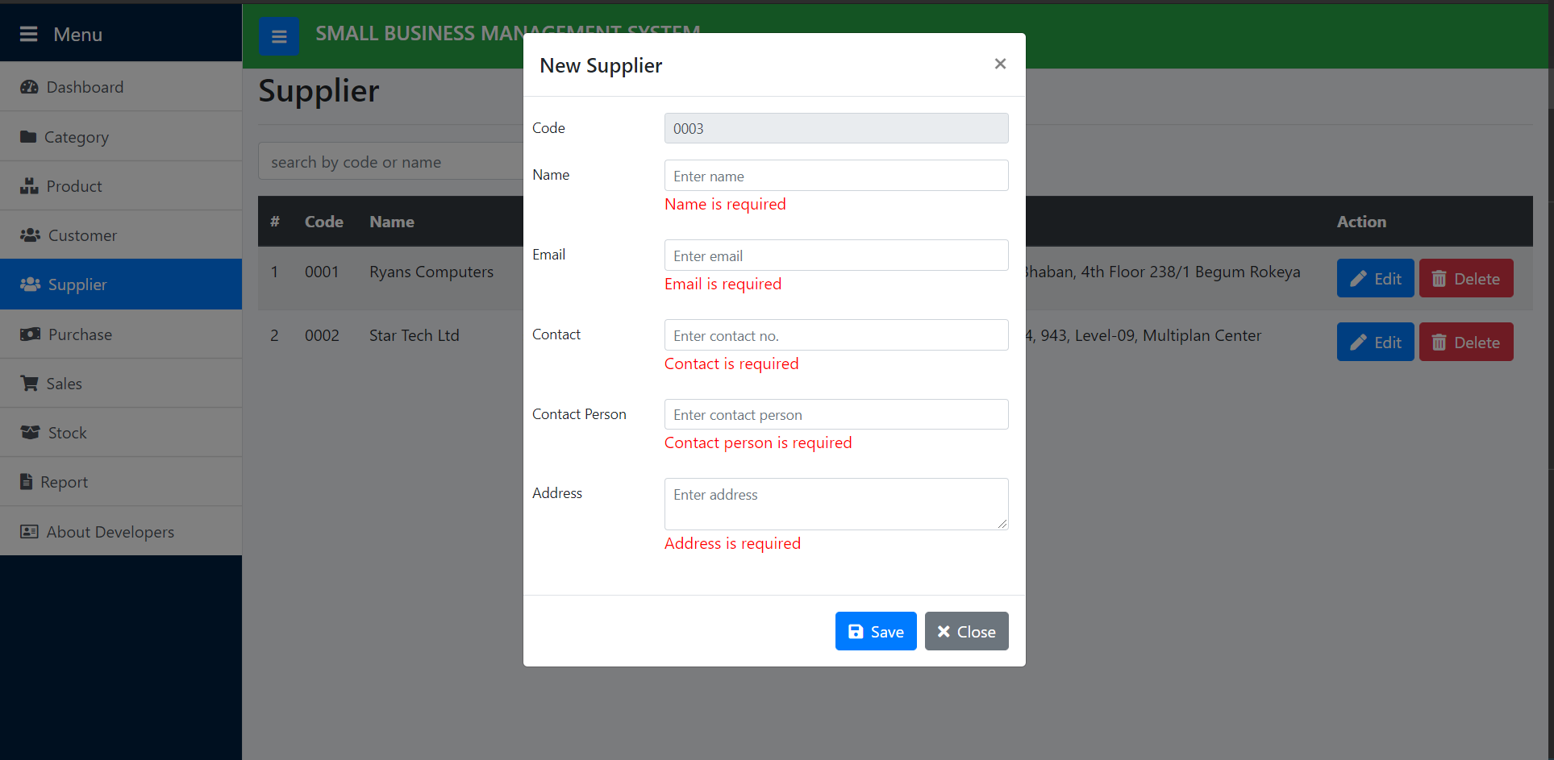
Add New Supplier

Slide 28
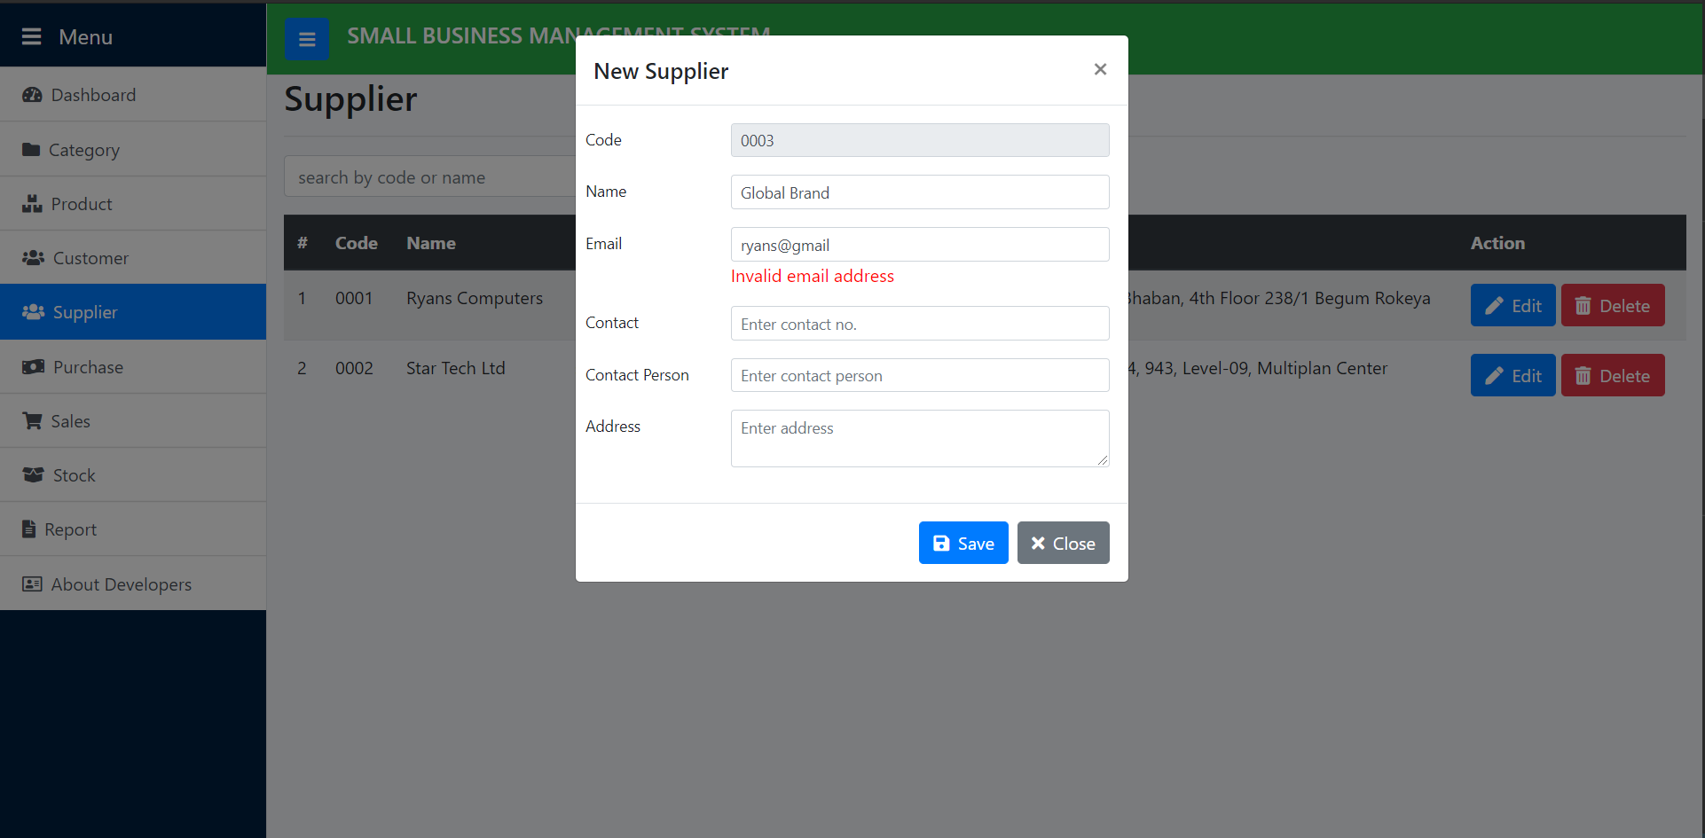
Supplier Email Invalid

Slide 29
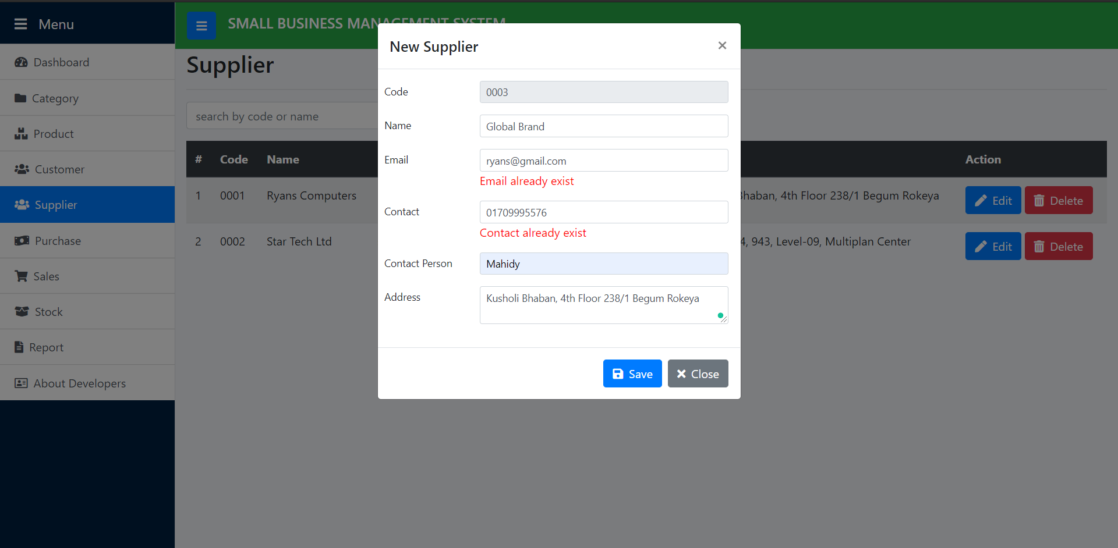
Supplier Unique Email and Unique Contact

Slide 30
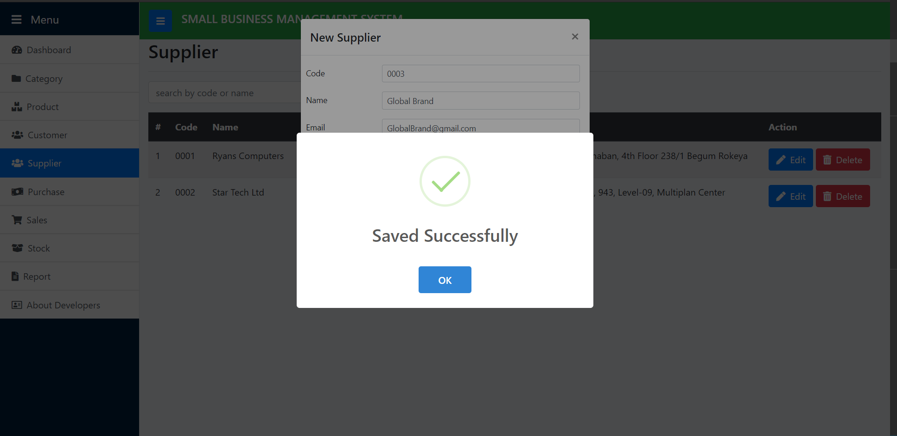
Supplier Save

Slide 31
Purchase Module

Slide 32
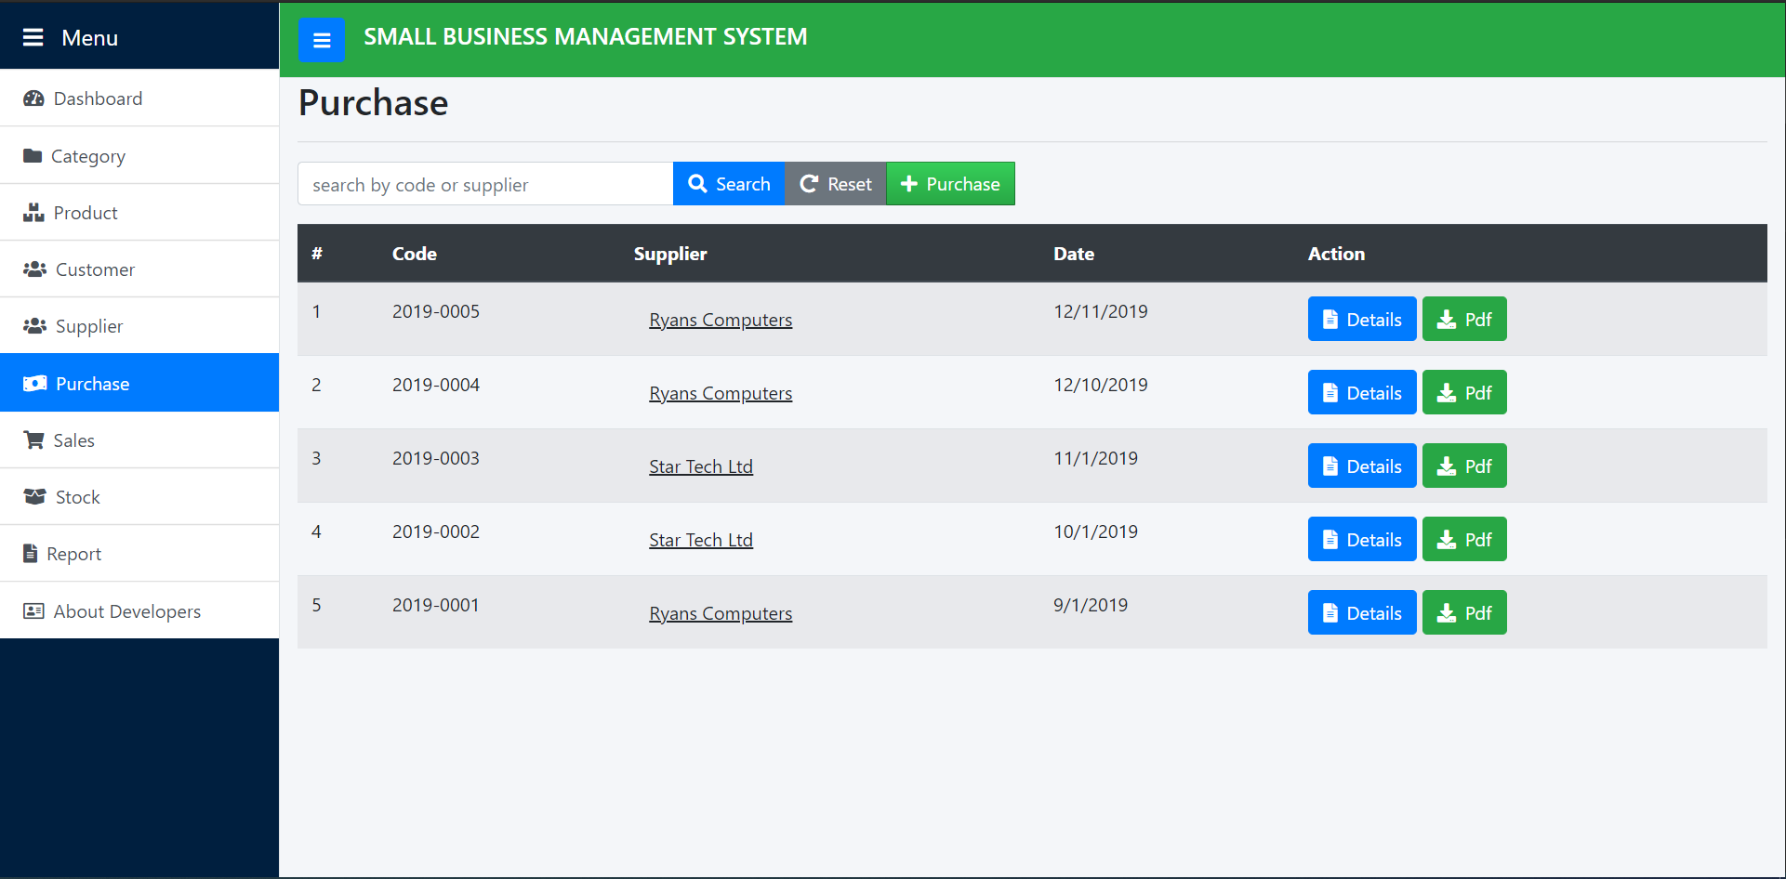
Purchase List

Slide 33
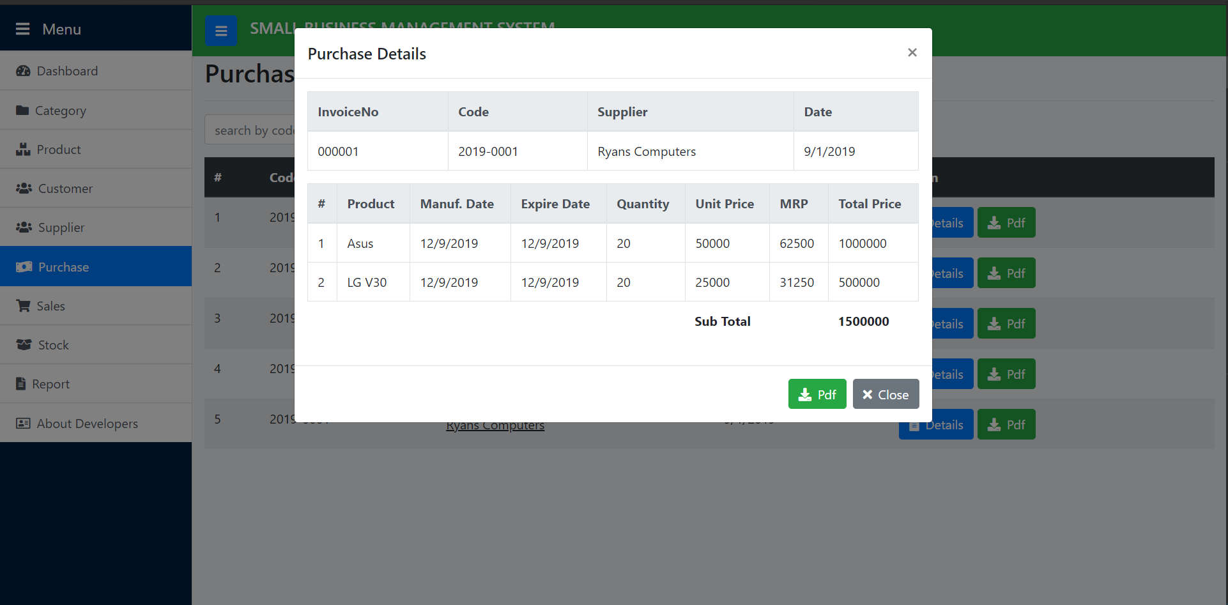
Purchase Details

Slide 34
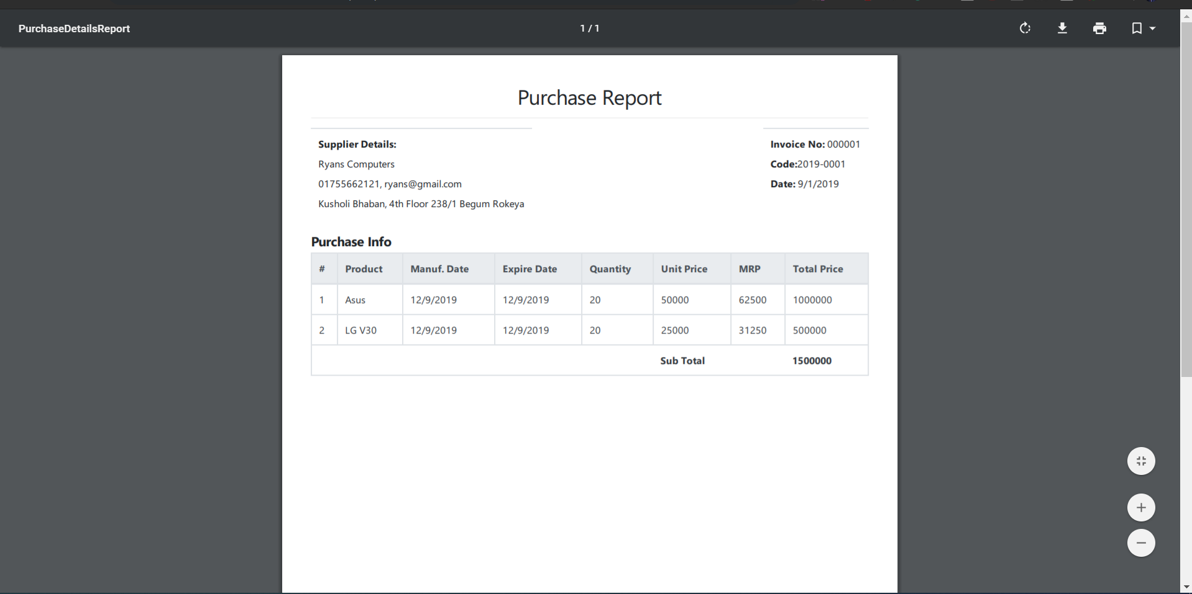
Purchase Details Pdf Report

Slide 35
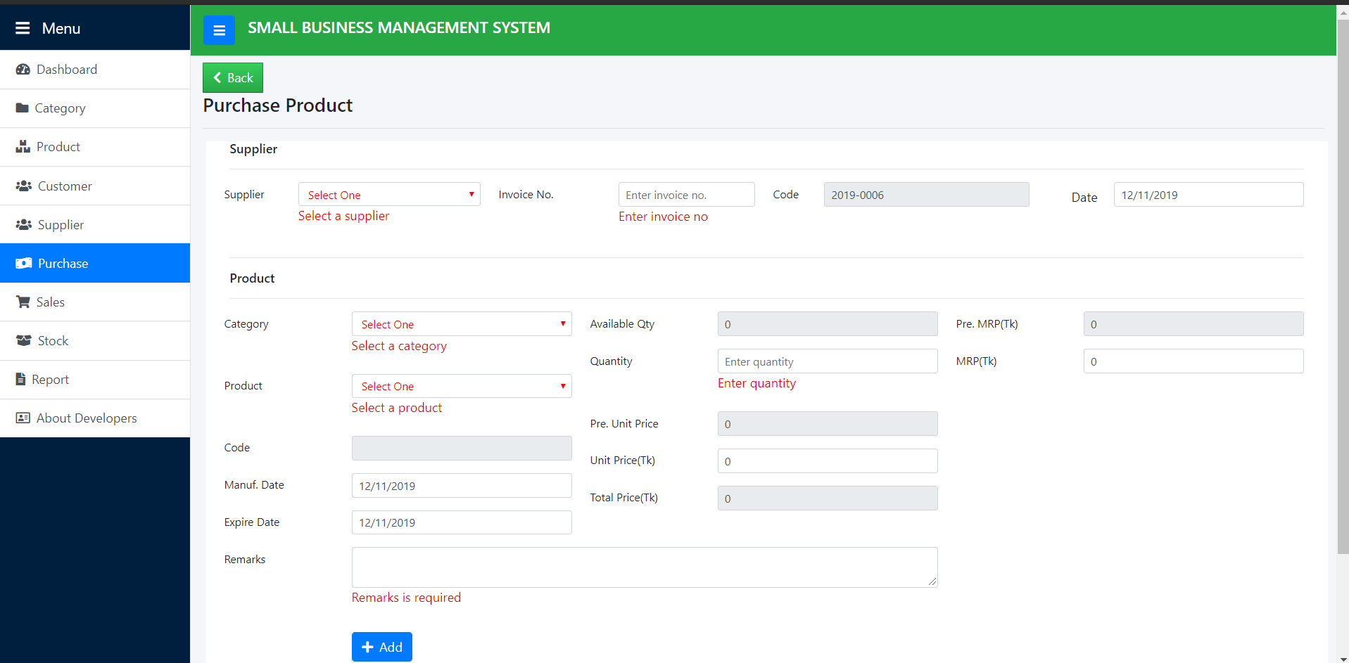
Purchase Products Validation

Slide 36
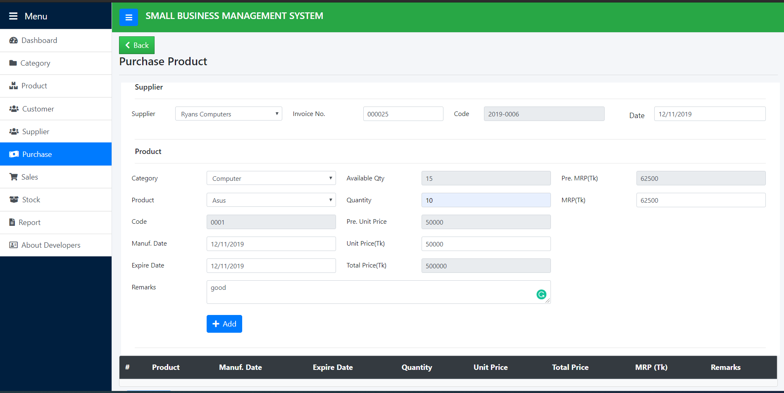
Purchase Product

Slide 37
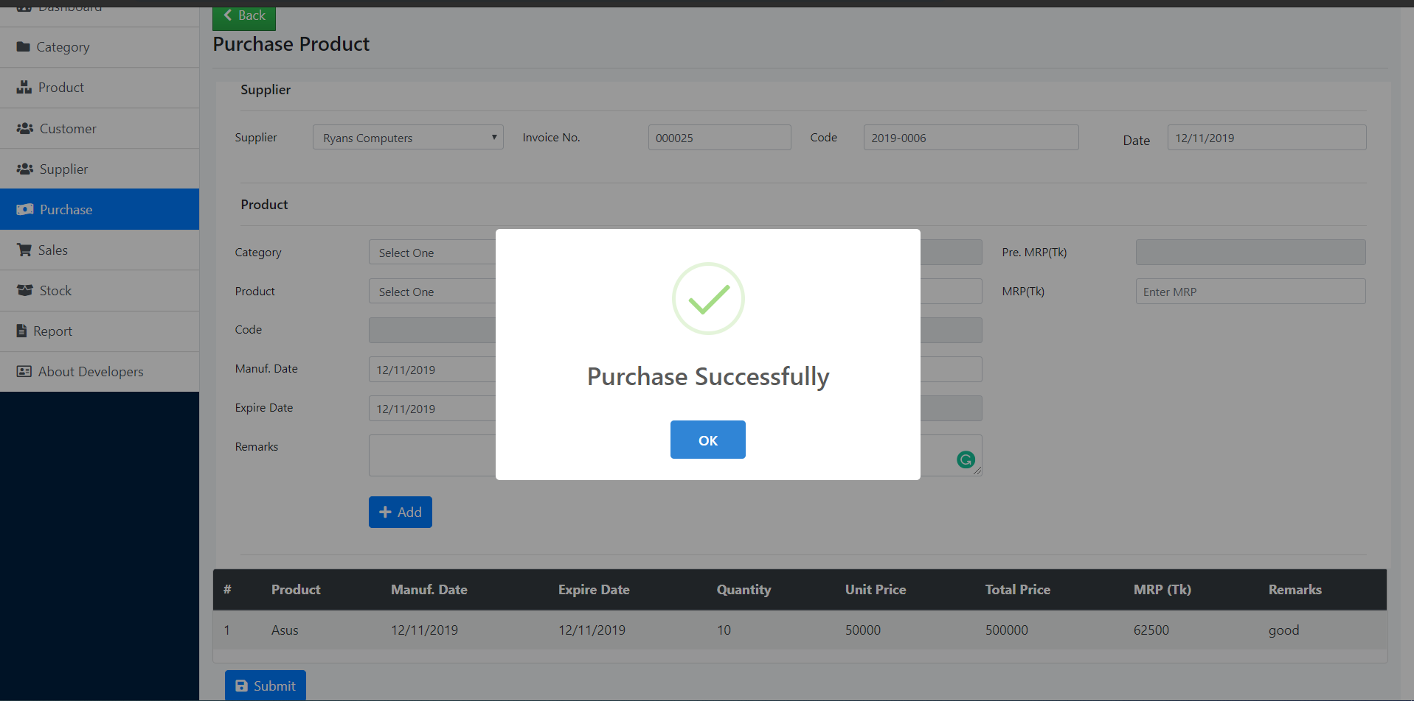
Purchase Successful

Slide 38
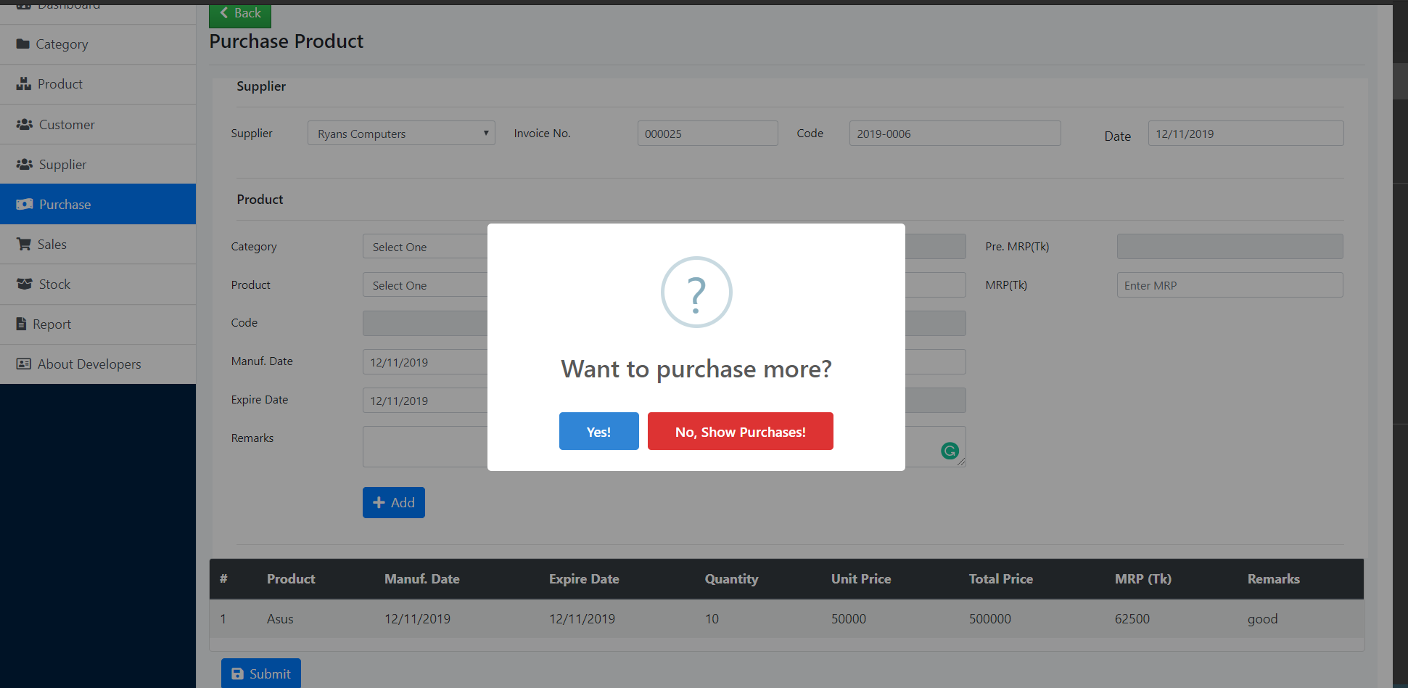
After Purchase Message

Slide 39
Sales Module

Slide 40
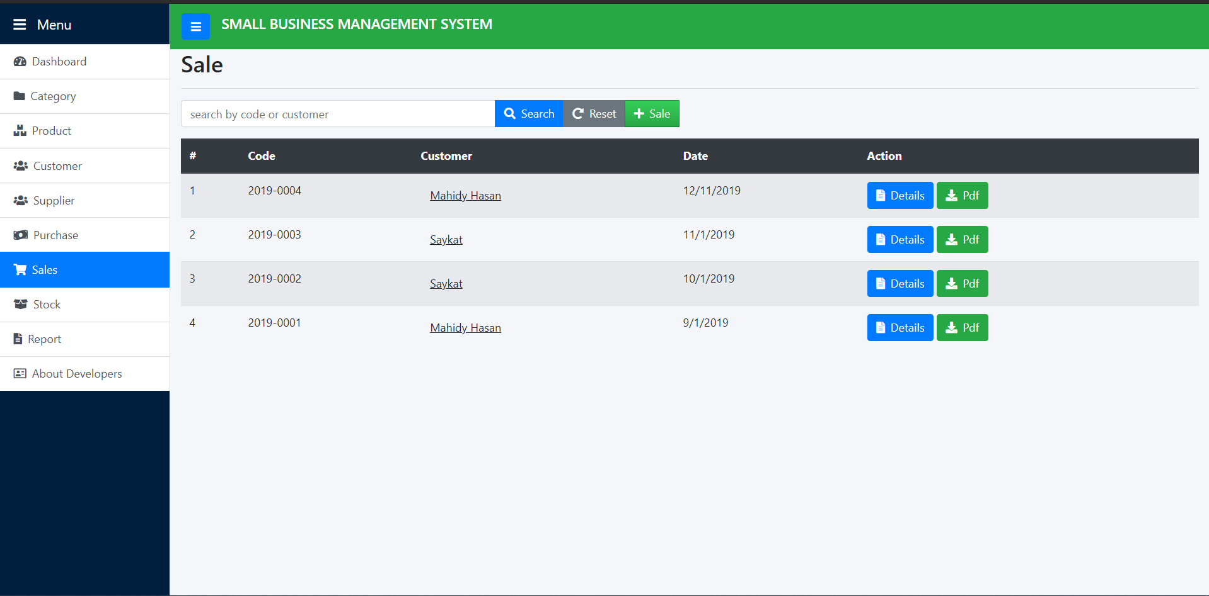
Sale List

Slide 41
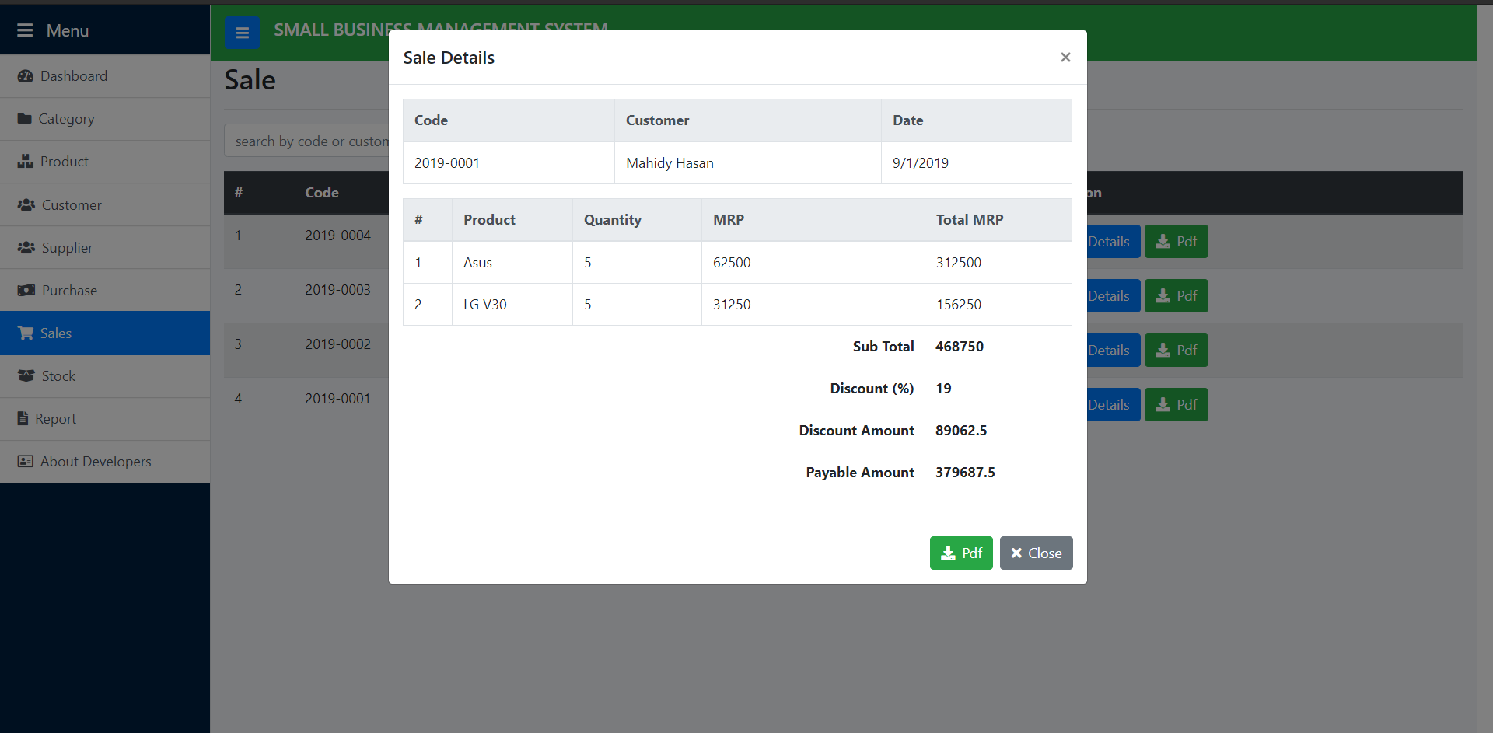
Sale Details

Slide 42
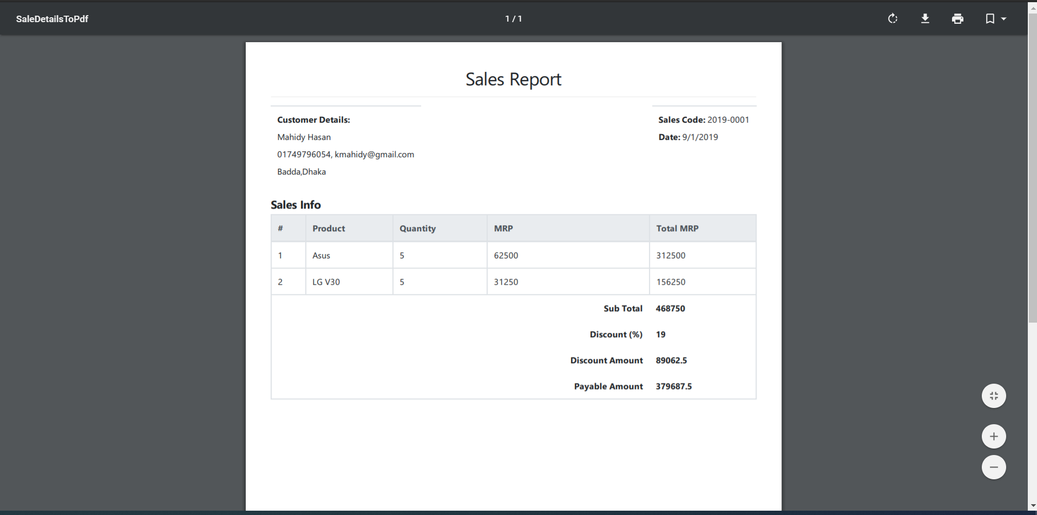
Sale Details Pdf Report

Slide 43
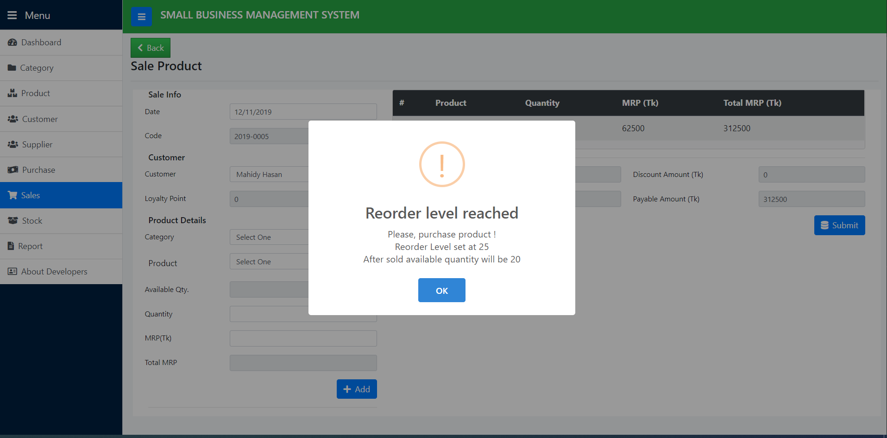
After Sale Add Button Click

Slide 44
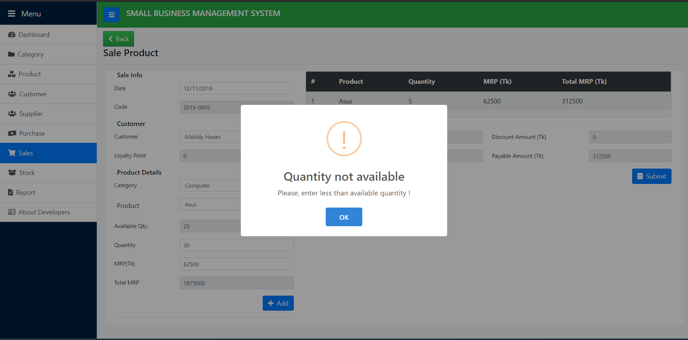
Sale Quantity Input

Slide 45
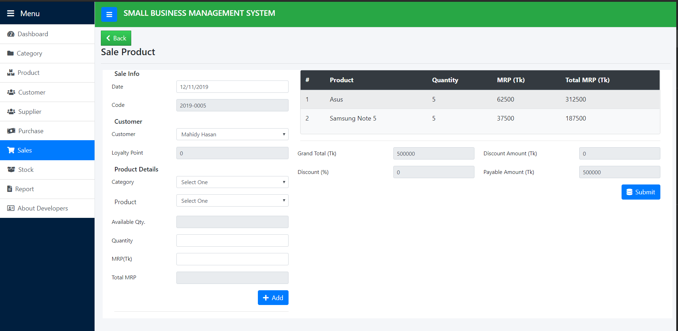
Sales Product Added List

Slide 46
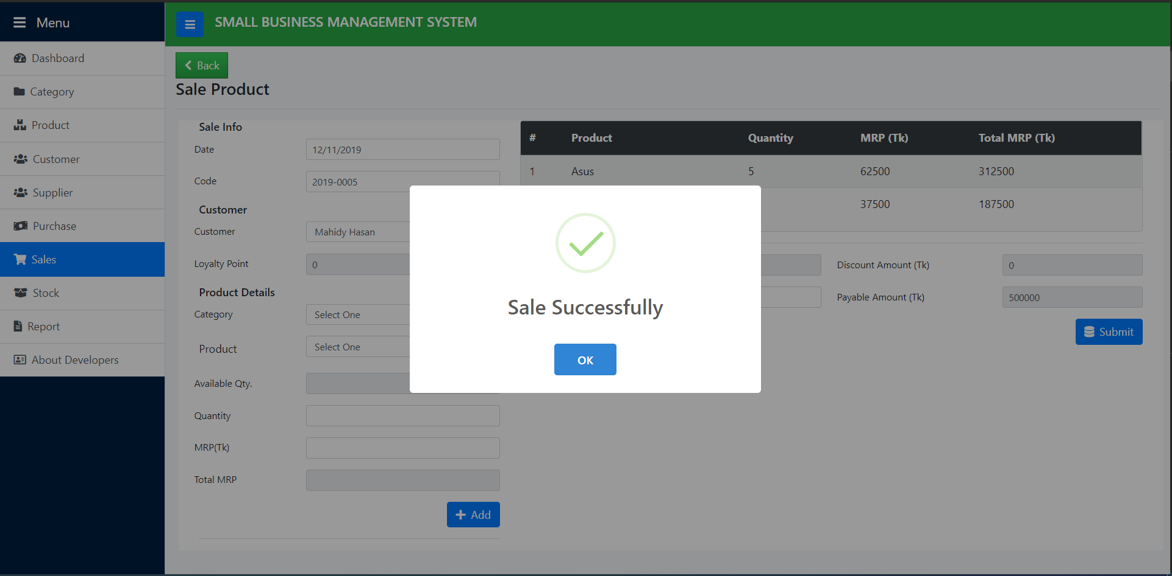
Sale Successful

Slide 47
Stock Module (Search/View)

Slide 48
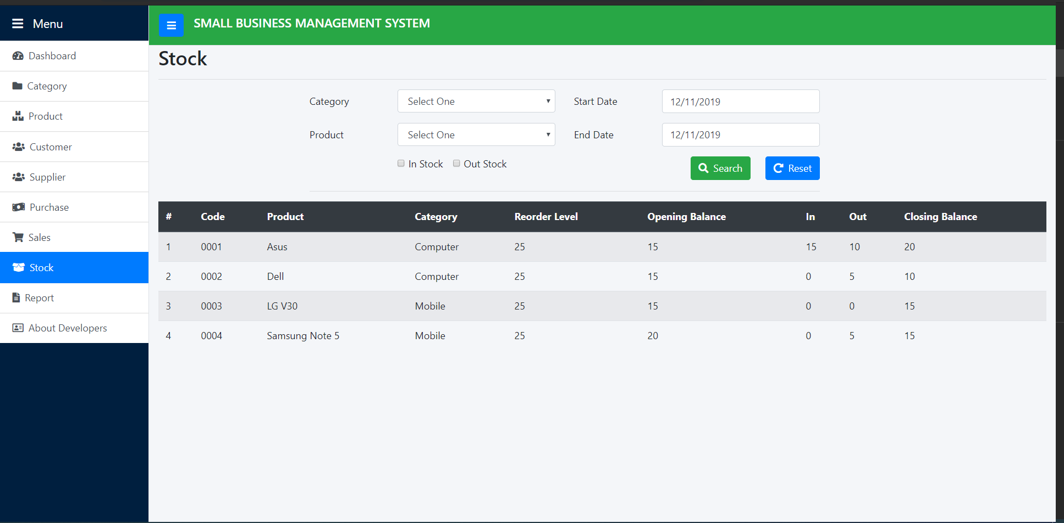
Stock Report Based on Current Date

Slide 49
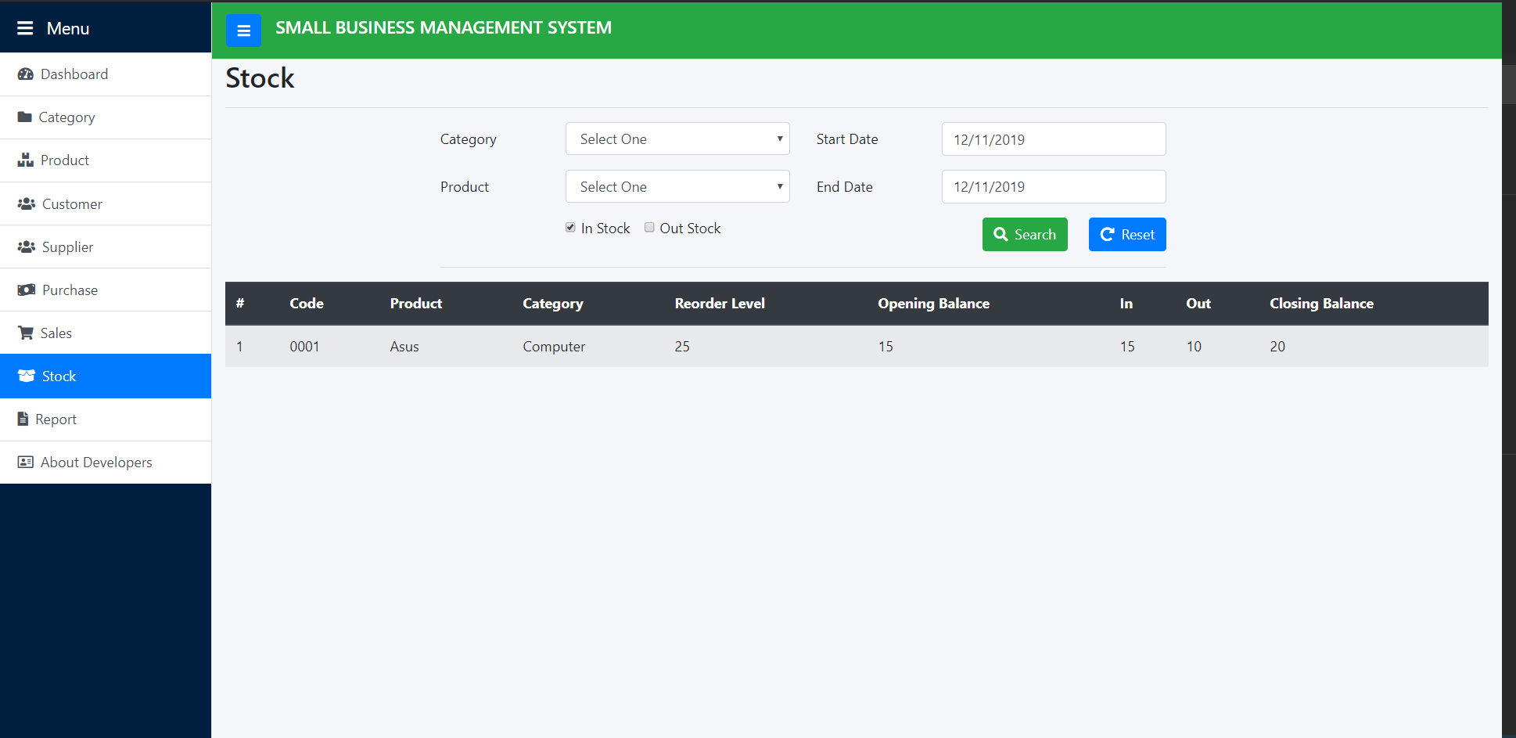
Stock In

Slide 50
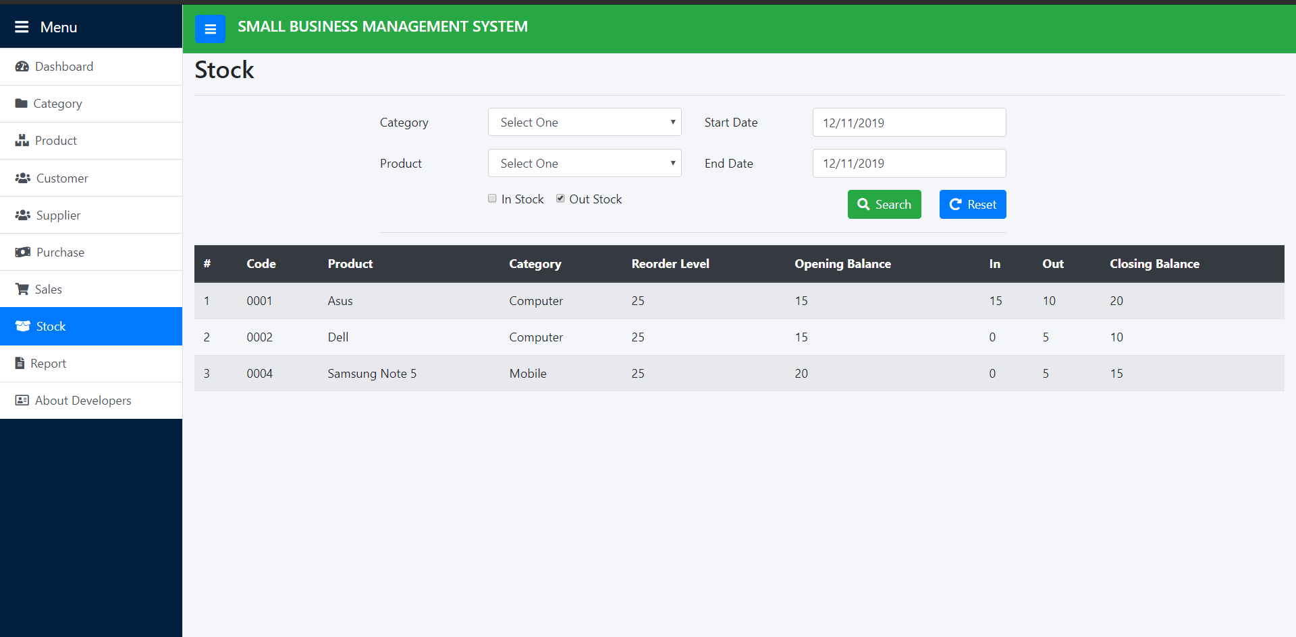
Stock Out

Slide 51
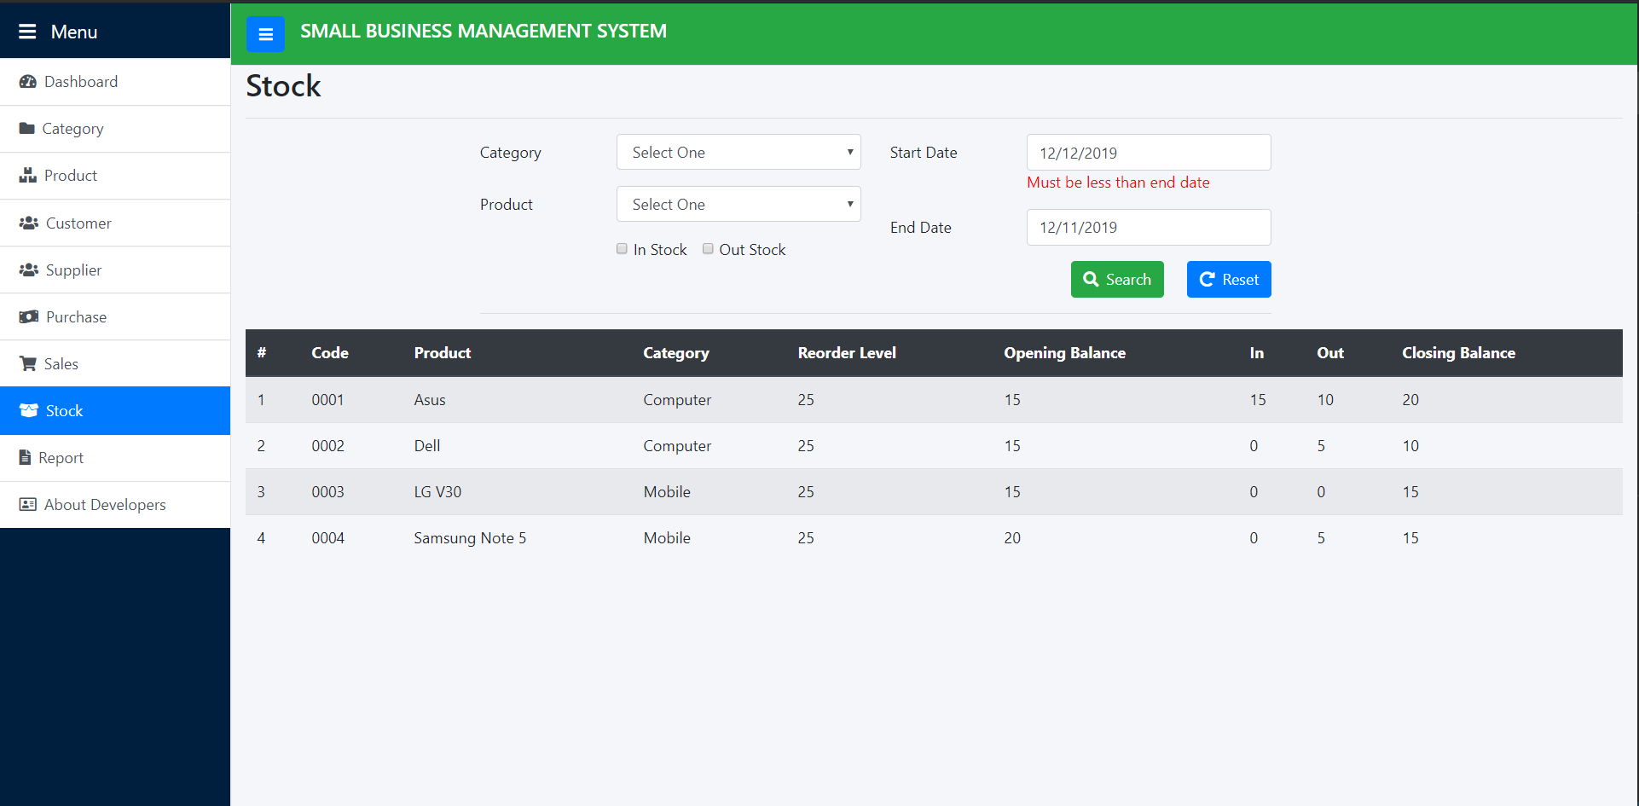
Stock Search Start Date Validation

Slide 52

Stock Search End Date Validation

Slide 53
Reporting Module (Periodic Income Expense Report on Sales)

Slide 54
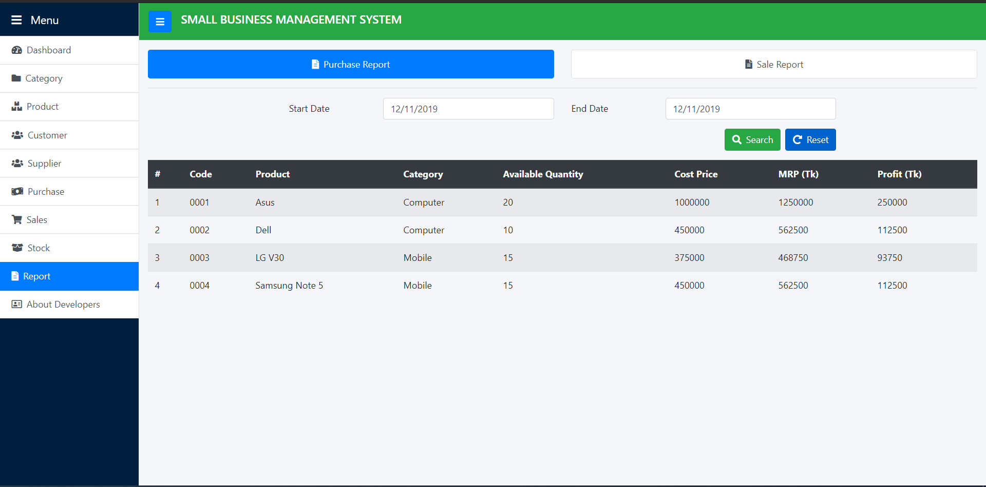
Purchase Report Based on Current Date

Slide 55
Reporting Module (Periodic Income Expense Report on Purchase)

Slide 56
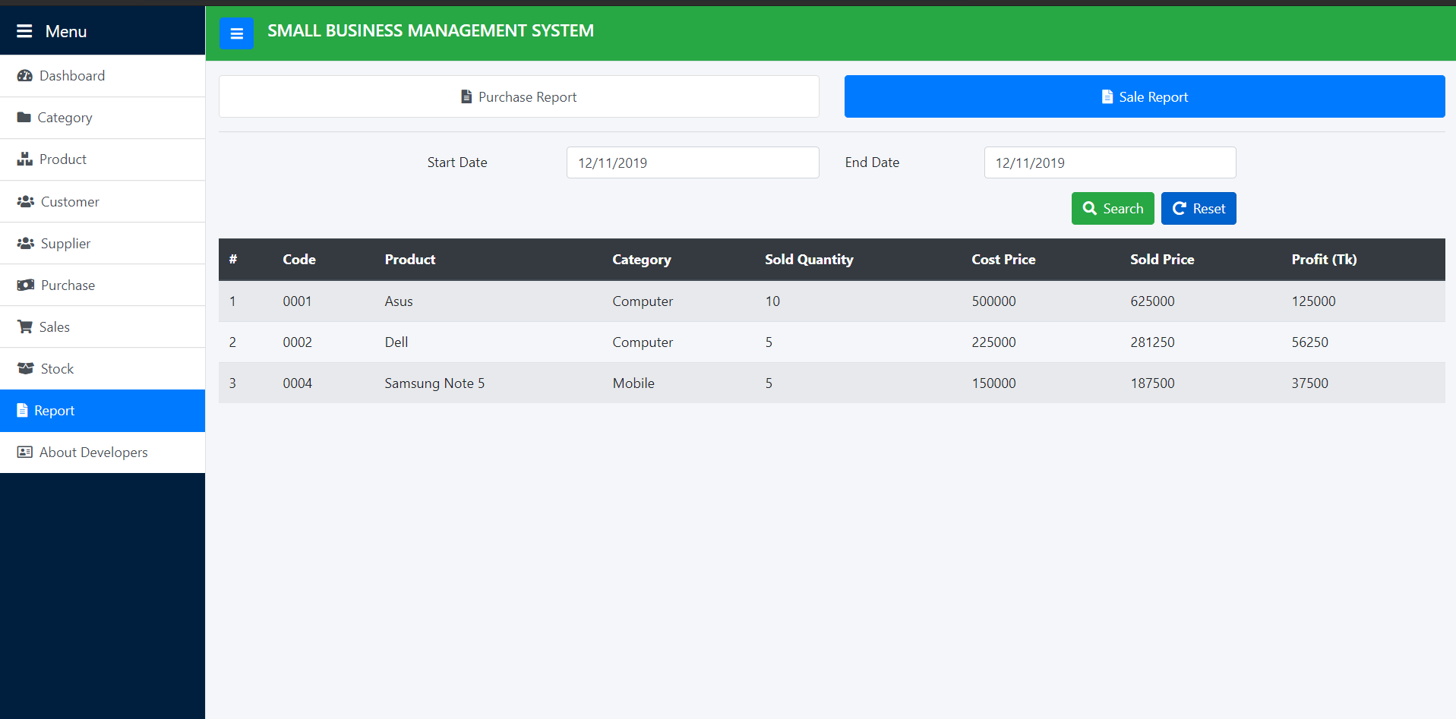
Sale Report Based on Current Date

Slide 57
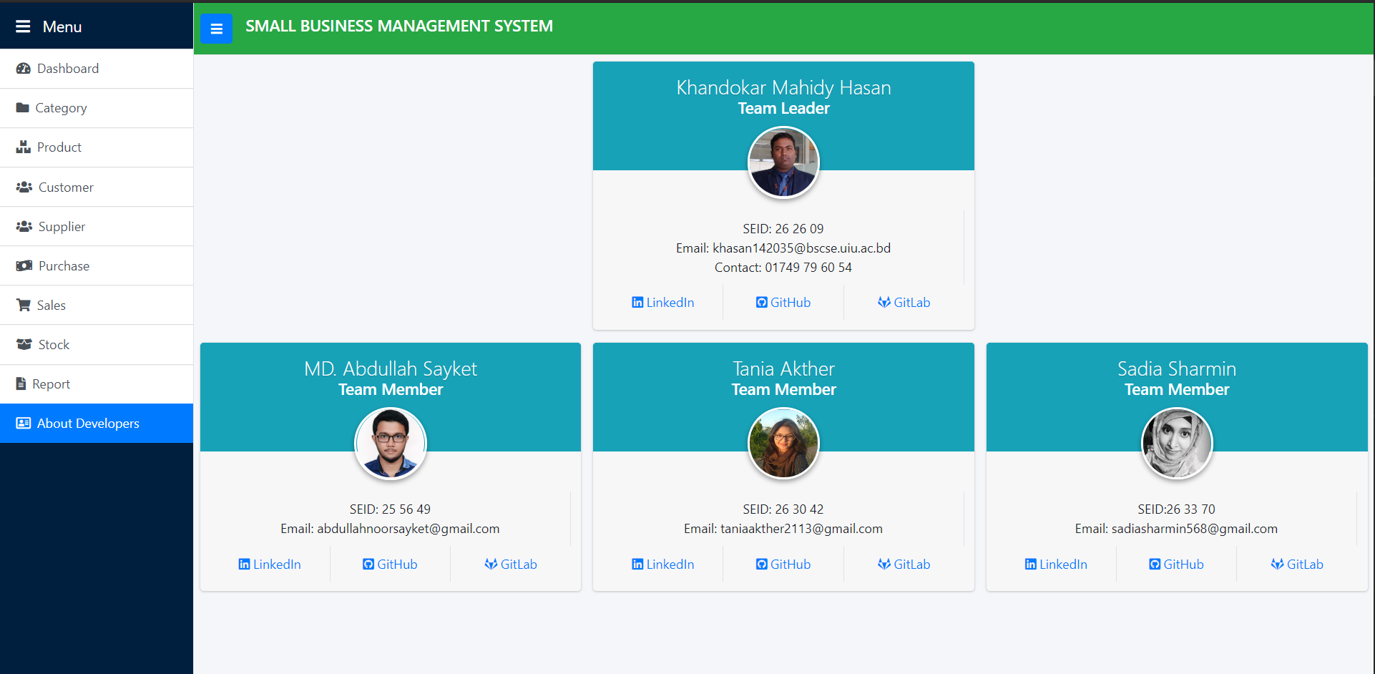
About Developers

Slide 58
Thank You !

